Slide 1
Chapter 9
Measuring Investment Performance: The Concept of Returns

Slide 2
CHAPTER OUTLINE
9.1 Investment Returns: Basic Definitions and Classification
9.1.1 Two Fundamental Types of Return Measures
9.1.2 Advantages and Disadvantages of Periodic and Multiperiod Return Measures
9.2 Periodic Returns
9.2.1 Formal Definition of the Periodic Return
9.2.2 Time-Weighted Investment
9.2.3 NCREIF Index Return Formula
9.2.4 Real versus Nominal Returns
9.2.5 Measuring Risk in Returns
9.2.6 Relationship between Risk and Return
9.2.7 Summarizing Periodic Returns: Synthesizing the Three Ways to Break Down the Total Return
9.3 Multiperiod and Money-Weighted Returns
9.3.1 Time-Weighted Average Return
9.3.2 Internal Rate of Return (IRR)
9.4 Chapter Summary

Slide 3
LEARNING OBJECTIVES
After reading this chapter, you should understand:
What is meant by investment returns and how to quantify both period-by-period total returns and IRRs.
The two major components of the total return, and why they are important.
The characteristic features of the main types of returns, and when it is best to use each type.
What is meant by risk in investment, how to quantify risk, and how it relates to returns.
How to account for inflation in return measures.
The NCREIF Property Index (NPI) and how the NPI return formula is derived.

Slide 4
9.1 Investment Returns: Basic Definitions and Classification

Slide 5
9.1.1 Two Fundamental Types of Return Measures

Slide 6
9.1.2 Advantages and Disadvantages of Periodic and Multiperiod Return Measures

Slide 7
9.2 Periodic Returns

Slide 8
9.2.1 Formal Definition of the Periodic Return

Slide 9
9.2.2 Time-Weighted Investment

Slide 10
9.2.3 NCREIF Index Return Formula

Slide 11
9.2.4 Real versus Nominal Returns

Slide 12
9.2.5 Measuring Risk in Returns

Slide 13
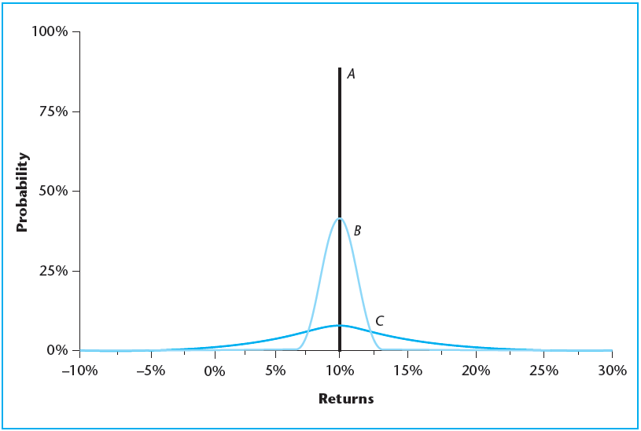
EXHIBIT 9-1 Risk and Expected Return as Future Return Probability Distributions: Three Assets
Copyright © 2021 Mbition LLC. All rights reserved.

Slide 14
9.2.6 Relationship between Risk and Return

Slide 15
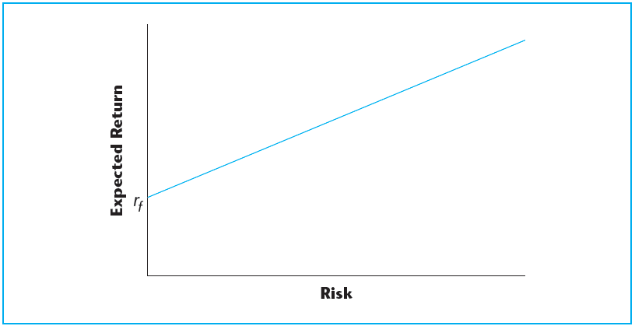
EXHIBIT 9-2 Financial Economics in a Nutshell: Risk and Return
Copyright © 2021 Mbition LLC. All rights reserved.

Slide 16
9.2.7 Summarizing Periodic Returns: Synthesizing the Three Ways to Break Down the Total Return

Slide 17
9.3 Multiperiod and Money-Weighted Returns

Slide 18
9.3.1 Time-Weighted Average Return

Slide 19
9.3.2 Internal Rate of Return (IRR)

Slide 20
9.4 Chapter Summary

Slide 21
KEY TERMS
returns
ex post
ex ante
period-by-period (periodic) returns
multiperiod returns
holding period returns (HPR)
time-weighted return (TWR)
internal rate of return (IRR)
money-weighted return (dollar-weighted return)
comovement
total return
income return
appreciation return
current yield
capital return (gain, growth)
inflation (general, CPI)
real return
nominal returns
standard deviation
volatility
risk premium
risk-free interest rate
time value of money
arithmetic average return
geometric average return
chain-linking (compounding) returns

