Slide 1
Chapter 4
Inside the City I: Some
Basic Urban Economics

Slide 2
CHAPTER OUTLINE
A Threshold Concept: Urban Form
4.1 Some Basic Economic Principles of Urban Land Value and Use
4.1.1 Location and the Residual Nature of Land Value
4.1.2 Competition, Equilibrium, and Highest and Best Use
4.1.3 Role of Transport Costs: The Bid-Rent Curve
4.1.4 Summary of Basic Urban Land Value and Land Use Principles
4.2 Classic Monocentric City Model
4.2.1 Circlopolis, the Quintessential Monocentric City
4.2.2 Using the Model: Some Principles about How Rents and City Size Change
4.2.3 Summarizing the Monocentric Model
4.3 Chapter Summary

Slide 3
LEARNING OBJECTIVES
After reading this chapter, you should understand:
What determines land rents in a city.
Why and how a freely functioning, competitive land market will lead to land being used at its “highest and best use” (i.e., most productive use).
What determines the relative land values at different locations within a city and the relative growth rate of these values at different locations.

Slide 4
A Threshold Concept: Urban Form

Slide 5
4.1 Some Basic Economic Principles of Urban Land Value and Use

Slide 6
4.1.1 Location and the Residual Nature of Land Value

Slide 7
4.1.2 Competition, Equilibrium, and Highest and Best Use

Slide 8
EXHIBIT 4-1 Highest and Best Use Example
Copyright © 2021 Mbition LLC. All rights reserved.

Slide 9
4.1.3 Role of Transport Costs: The Bid-Rent Curve

Slide 10
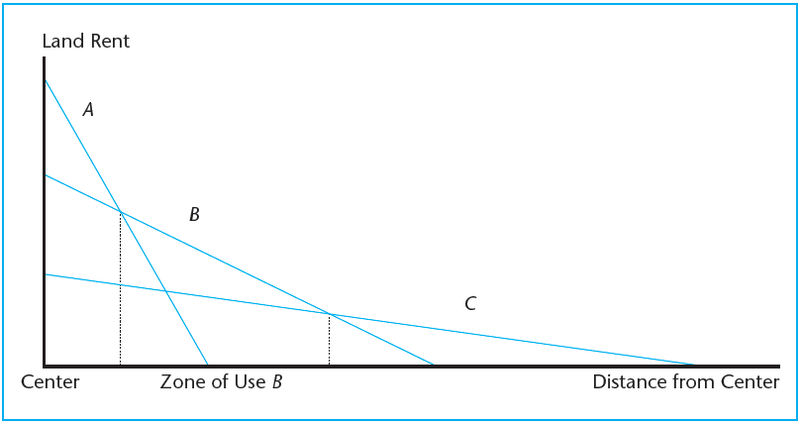
EXHIBIT 4-2 Bid-Rent Functions of Three Land Uses with Differing Productivity and Sensitivity to Transport Cost
Copyright © 2021 Mbition LLC. All rights reserved.

Slide 11
4.1.4 Summary of Basic Urban Land Value and Land Use Principles

Slide 12
4.2 Classic Monocentric City Model

Slide 13
4.2.1 Circlopolis, the Quintessential Monocentric City

Slide 14
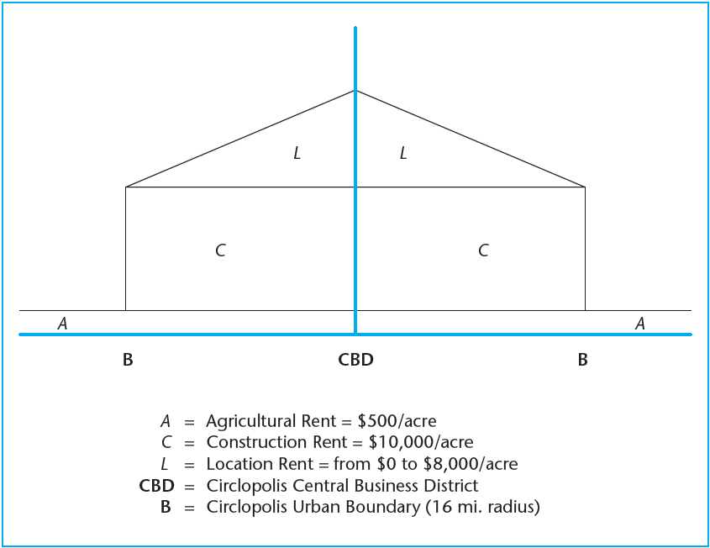
EXHIBIT 4-3 Cross-Section of Real Property Rents in Circlopolis and Agricolia
Copyright © 2021 Mbition LLC. All rights reserved.

Slide 15
4.2.2 Using the Model: Some Principles about How Rents and City Size Change

Slide 16
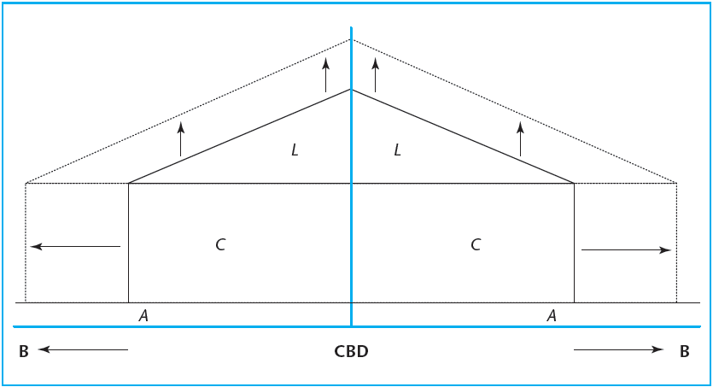
EXHIBIT 4-4 Effect of Population Growth with Density and Transport Cost Constant
Copyright © 2021 Mbition LLC. All rights reserved.

Slide 17
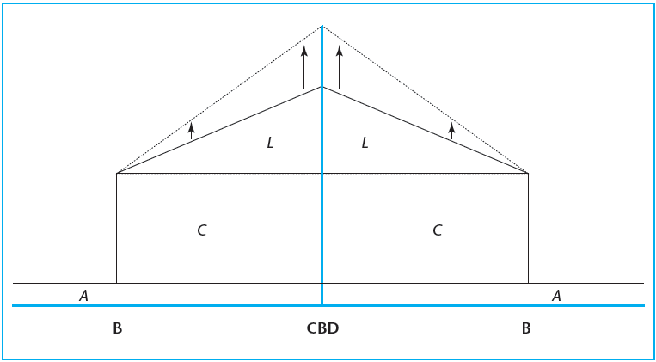
EXHIBIT 4-5 Effect of Population Growth with Area Constant
Copyright © 2021 Mbition LLC. All rights reserved.

Slide 18
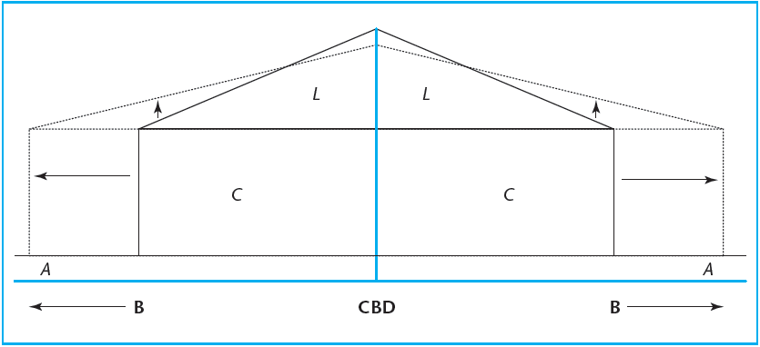
EXHIBIT 4-6 Effect of Transport Cost Reduction Savings Applied to Greater Purchase of Land
Copyright © 2021 Mbition LLC. All rights reserved.

Slide 19
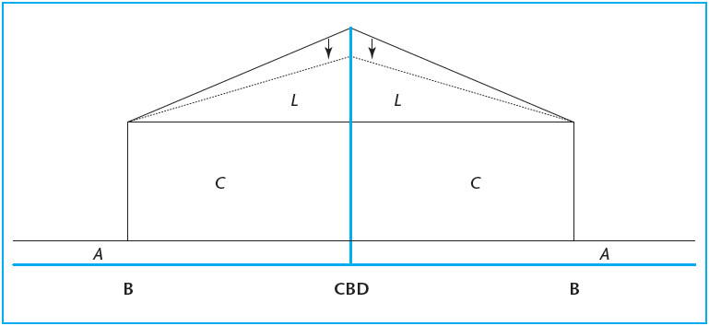
EXHIBIT 4-7 Effect of Transport Cost Reduction Savings Not Applied to Purchase of Land
Copyright © 2021 Mbition LLC. All rights reserved.

Slide 20
4.2.3 Summarizing the Monocentric Model

Slide 21
4.3 Chapter Summary

Slide 22
KEY TERMS
urban form
factor of production
residual theory of land value
mobile factors
highest and best use (HBU)
bid-rent curve (function)
central point
transportation cost minimized
monocentric city
radius to the urban boundary
agricultural rent
construction cost rent
rent gradient
location rent (location premium)

