Slide 1
Chapter 29
Investment Analysis of Real Estate Development Projects, Part 2: Economic Analysis

Slide 2
CHAPTER OUTLINE
29.1 The Basic Idea
29.1.1 Applying NPV to Development Projects
29.1.2 Operational Leverage and Estimation of the OCC for Development Investments
29.1.3 The Development Risk Ratio and Implications for Characteristic Development Regions
*29.2 Advanced Topic: The Relationship of Development Valuation to the Real Option Model of Land Value
29.3 Broadening The Perspective
29.3.1 How Developers Think about All This
* 29.3.2 “Soup to Nuts:” Including Lease-up and Land Assembly: “Unblending” the Blended IRR
29.4 Evaluating Multiphase Developments: Real Options Theory and a Simplification
29.5 Chapter Summary

Slide 3
LEARNING OBJECTIVES
After reading this chapter, you should understand:
The more rigorously correct NPV-based approach to financial evaluation of development projects.
The relationship of operational leverage to development project risk and return.
How to estimate the opportunity cost of capital or reasonable expected return for real estate development project investments.
The role of option valuation theory in analysis and evaluation of multiphase development projects.

Slide 4
29.1 The Basic Idea

Slide 5
29.1.1 Applying NPV to Development Projects

Slide 6
29.1.2 Operational Leverage and Estimation of the OCC for Development Investments

Slide 7
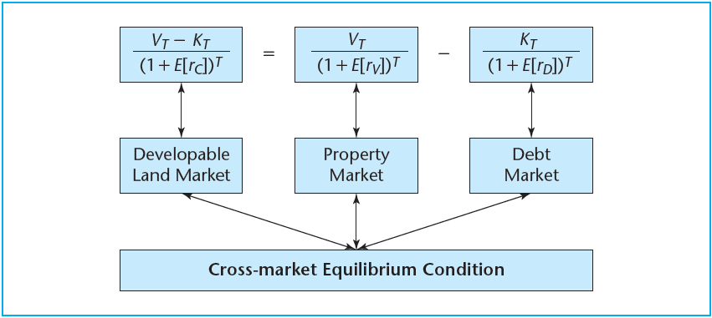
EXHIBIT 29-1 The “Canonical” Formula
Copyright © 2021 Mbition LLC. All rights reserved.

Slide 8
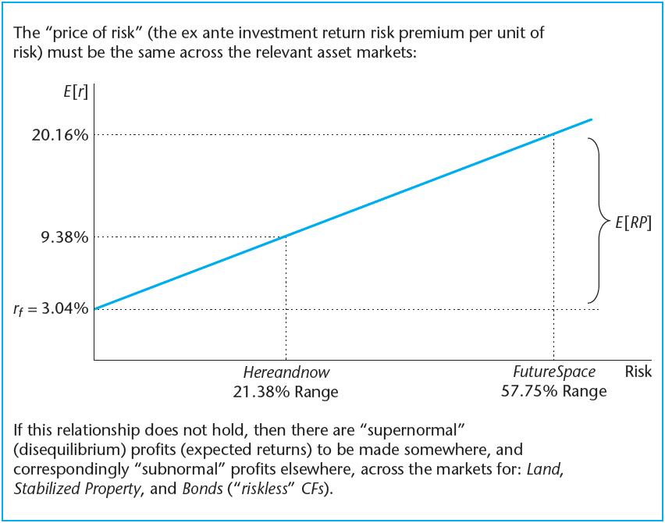
EXHIBIT 29-2 FutureSpace and Hereandnow Risk and Return Based on the Canonical Formula
Copyright © 2021 Mbition LLC. All rights reserved.

Slide 9
29.1.3 The Development Risk Ratio and Implications for Characteristic Development Regions

Slide 10
*29.2 Advanced Topic: The Relationship of Development Valuation to the Real Option Model of Land Value

Slide 11
29.3 Broadening the Perspective

Slide 12
29.3.1 How Developers Think about All This

Slide 13
*29.3.2 “Soup to Nuts:” Including Lease-up and
Land Assembly: “Unblending” the Blended IRR

Slide 14
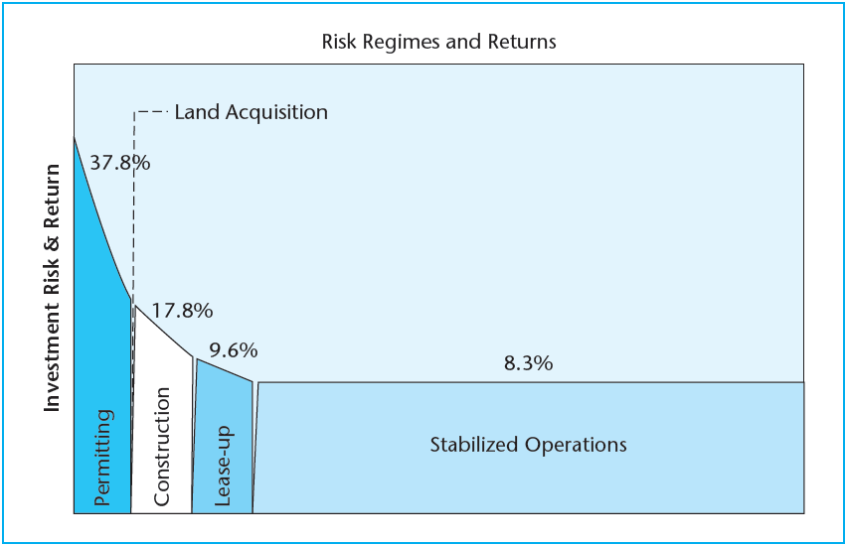
EXHIBIT 29-3 An Example of Risk and Return Regimes for Phases of the Development Process
Copyright © 2021 Mbition LLC. All rights reserved.
The example is taken from a study of affordable housing development in Massachusetts.

Slide 15
29.4 Evaluating Multiphase Developments: Real Options Theory and a Simplification

Slide 16
29.5 Chapter Summary

Slide 17
KEY TERMS
financial desirability
time-to-build
phased risk regimes
operational leverage
price of risk
canonical formula of development project OCC
real options model of land value
developmental risk ratio
profit margin ratio
enhanced cap rate on cost
blended long-run IRR
IRR “unblending”
parallel development phases
sequential development phases
compound option

