Slide 1
Chapter 25
Data Challenges in Measuring Real Estate Periodic Returns

Slide 2
CHAPTER OUTLINE
25.1 The Basics: Macro-Level Property Valuation
25.1.1 Transaction Noise and Appraisal Error
25.1.2 A Simple Example of Temporal Lag Bias
25.1.3 The Trade-Off between Noise and Lag
25.1.4 The Difference between Aggregate and Disaggregate Valuation
25.1.5 Summarizing Macro-Level Valuation Error
25.2 From Value Levels to Returns: The General Nature of Performance Measurement Errors
25.2.1 The Pure Effect of Random Noise
25.2.2 The Pure Effect of Temporal Lag
25.2.3 Putting the Two Effects Together
25.2.4 What About the Total Return?

Slide 3
CHAPTER OUTLINE (continued)
25.3 What Is Truth? Lags and the Time Line of Price Discovery in Real Estate
25.3.1 Multistep Real Estate Time Line of Information Incorporation into Observable Value
25.4 Innovations in Commercial Property Returns Indices
25.4.1 Overview of Types of Indices
25.4.2 Repeat-Sales Indices of Commercial Property Price Performance
25.5 Chapter Summary

Slide 4
LEARNING OBJECTIVES
After reading this chapter, you should understand:
The major types of errors that tend to be present in empirical real estate periodic return data.
The characteristic signs of such errors and the effects such errors have on analysis relevant to macro-level investment decision making.
The different ways in which it is conceptually possible to define real estate values and returns, the temporal relationship among these different definitions, and the relevance of different definitions for various types of practical decision problems.
The new price and return indexing innovations for tracking commercial property, including “repeat-sales” indices based directly on investors’ actual experiences in the private property market.

Slide 5
25.1 The Basics: Macro-Level Property Valuation

Slide 6
25.1.1 Transaction Noise and Appraisal Error

Slide 7
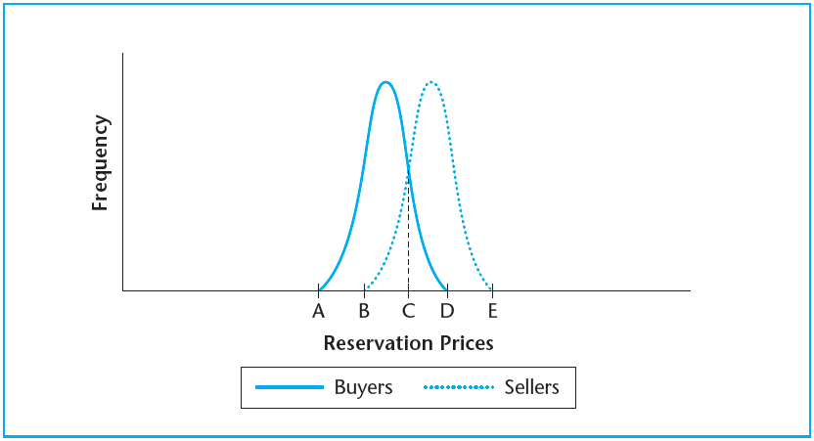
EXHIBIT 25-1 Buyer and Seller Populations, Reservation Price Frequency Distributions
Copyright © 2021 Mbition LLC. All rights reserved.

Slide 8
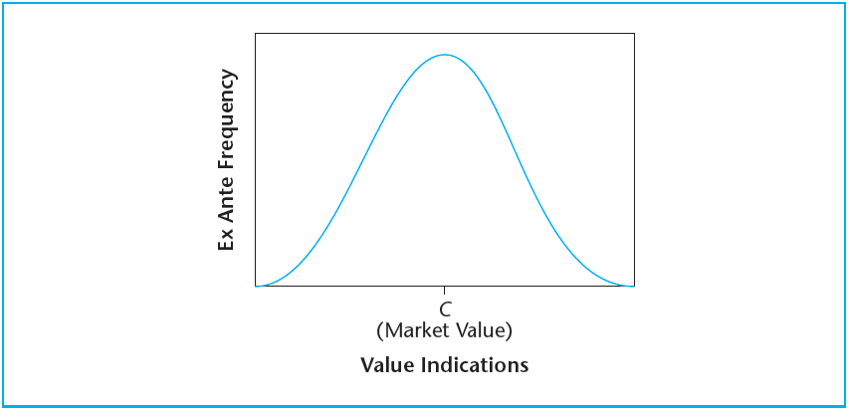
EXHIBIT 25-2 Theoretical Cross-Sectional Dispersion in Observable Value Indications
Copyright © 2021 Mbition LLC. All rights reserved.

Slide 9
25.1.2 A Simple Example of Temporal Lag Bias

Slide 10
25.1.3 The Trade-Off between Noise and Lag

Slide 11
25.1.4 The Difference between Aggregate and Disaggregate Valuation

Slide 12
25.1.5 Summarizing Macro-Level Valuation Error

Slide 13
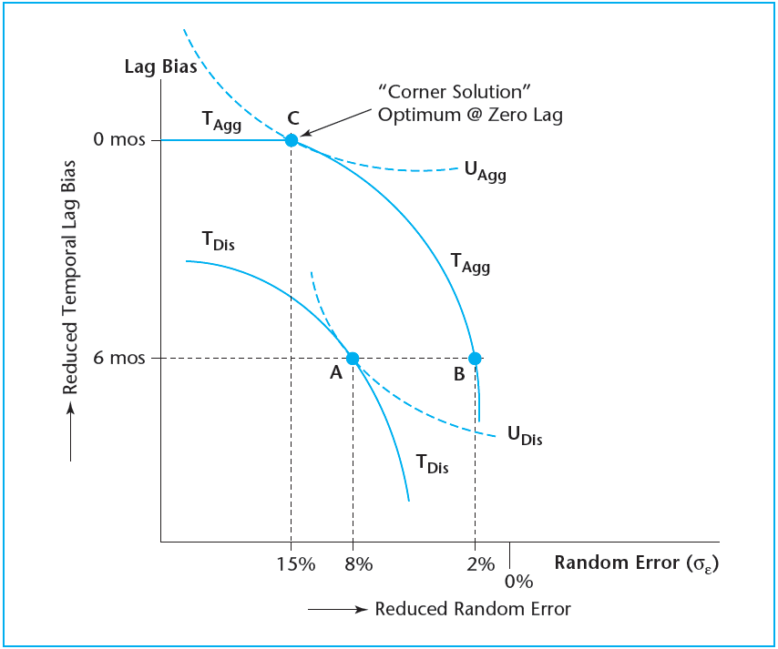
EXHIBIT 25-3 Noise-versus-Lag Trade-Off Frontiers with Disaggregate and Aggregate Valuation Methodologies
Copyright © 2021 Mbition LLC. All rights reserved.

Slide 14
25.2 From Value Levels to Returns: The General Nature of Performance Measurement Errors

Slide 15
25.2.1 The Pure Effect of Random Noise

Slide 16
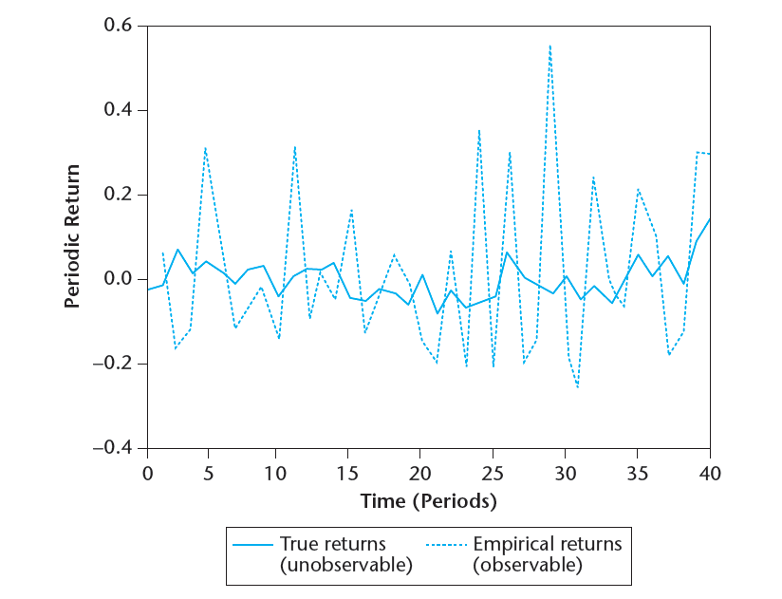
EXHIBIT 25-4A The Pure Effect of Noise in Periodic Returns
Copyright © 2021 Mbition LLC. All rights reserved.

Slide 17
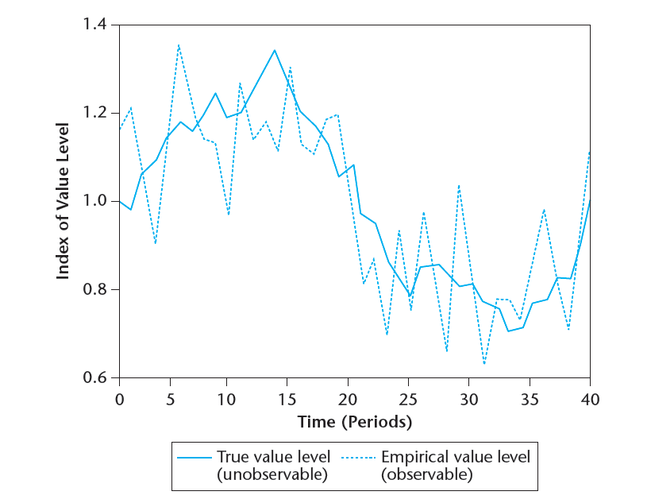
EXHIBIT 25-4B The Pure Effect of Noise in Periodic Value Levels
Copyright © 2021 Mbition LLC. All rights reserved.

Slide 18
25.2.2 The Pure Effect of Temporal Lag

Slide 19
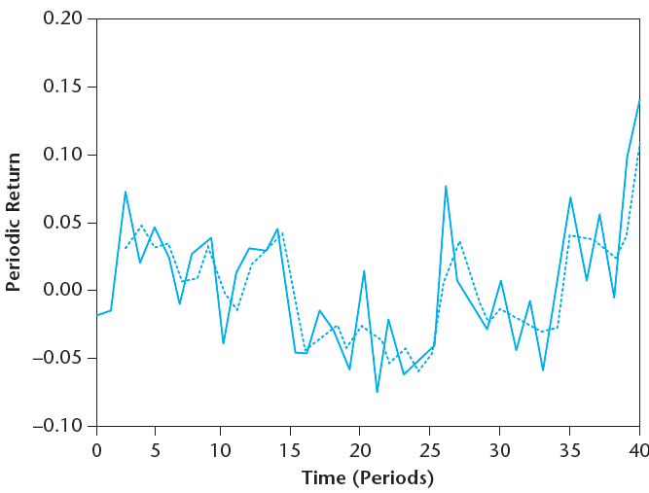
EXHIBIT 25-5A The Pure Effect of Temporal Lag in Periodic Returns
Copyright © 2021 Mbition LLC. All rights reserved.

Slide 20
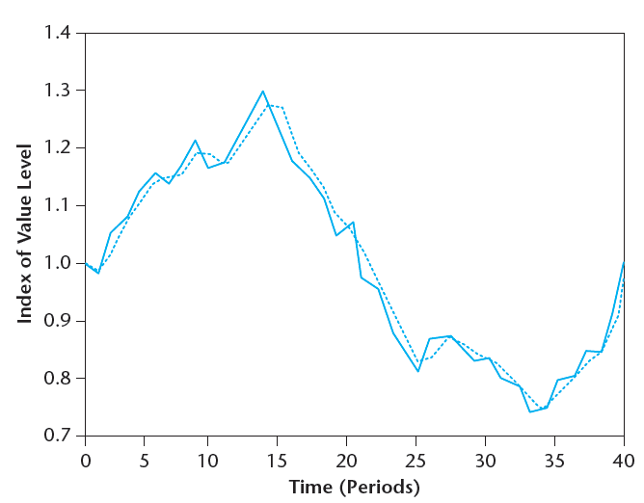
EXHIBIT 25-5B The Pure Effect of Temporal Lag in Periodic Value Levels
Copyright © 2021 Mbition LLC. All rights reserved.

Slide 21
25.2.3 Putting the Two Effects Together

Slide 22
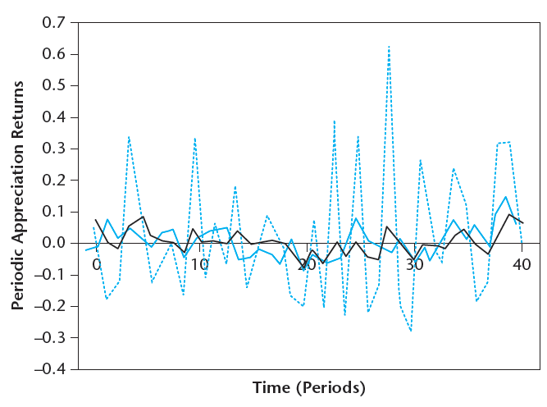
EXHIBIT 25-6A Periodic Appreciation Returns Based on Market Values, Transaction Prices, and Appraised Values (simulated data)
Copyright © 2021 Mbition LLC. All rights reserved.

Slide 23
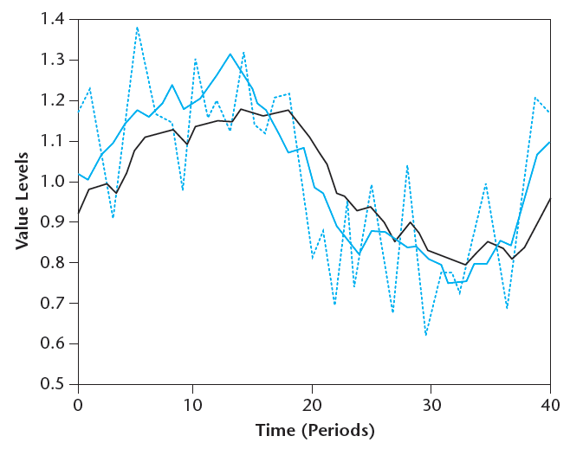
EXHIBIT 25-6B Market Values, Transaction Prices, and Appraised Values (simulated data)
Copyright © 2021 Mbition LLC. All rights reserved.

Slide 24
25.2.4 What About the Total Return?

Slide 25
25.3 What Is Truth? Lags and the Time Line of Price Discovery in Real Estate

Slide 26
25.3.1 Multistep Real Estate Time Line of Information Incorporation into Observable Value

Slide 27
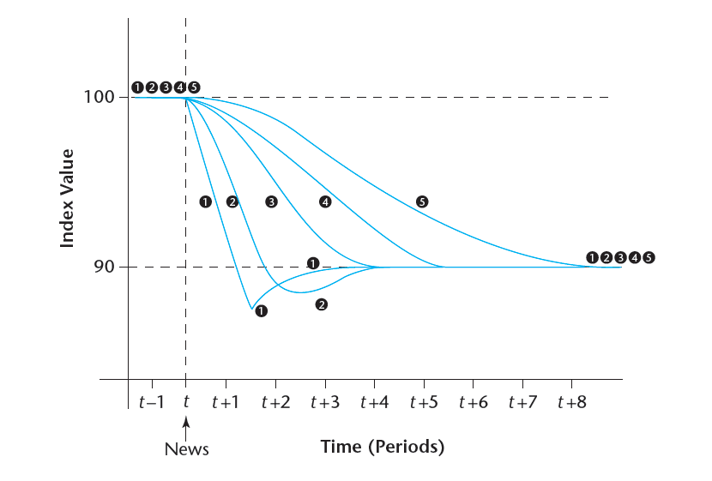
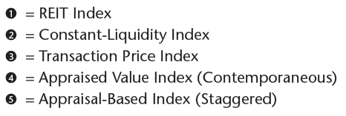
EXHIBIT 25-7 News-Response Time Line for Various Stylized Real Estate Indices
Copyright © 2021 Mbition LLC. All rights reserved.

Slide 28
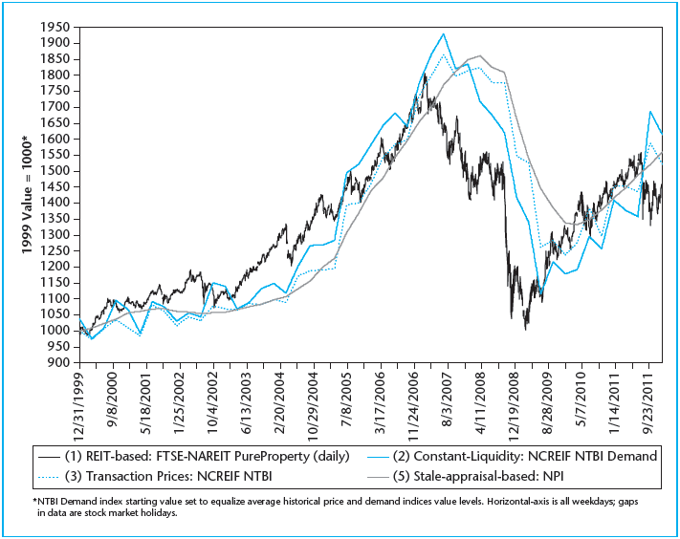
EXHIBIT 25-8 Four Definitions and Measures of U.S. Commercial Property Values, 2000–2011
Source: Author’s compilations from FTSE, NCREIF and the MIT Center for Real Estate.

Slide 29
25.4 Innovations in Commercial Property Returns Indices

Slide 30
25.4.1 Overview of Types of Indices

Slide 31
25.4.2 Repeat-Sales Indices of Commercial Property Price Performance

Slide 32
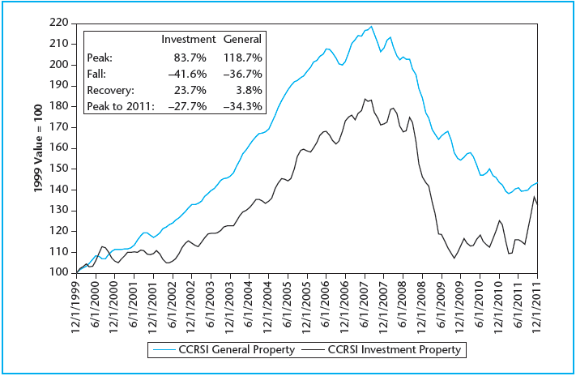
EXHIBIT 25-9 CoStar CCRSI, Investment vs. General Commercial Properties: Same-property (repeat-sales) Prices, 2000–2011
Source: CoStar Group Inc. Index values as of June 2012.

Slide 33
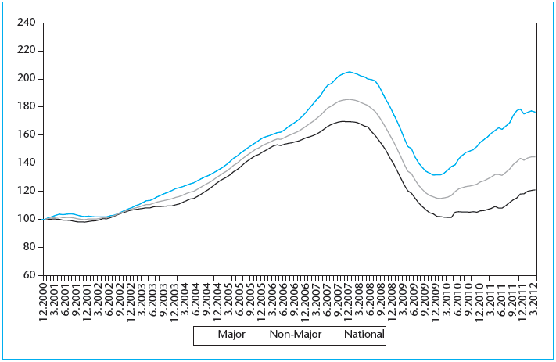
EXHIBIT 25-10 Moody’s/RCA CPPI, Major and Non-Major Markets Composite Indices
Source: Real Capital Analytics. Index histories as of June 2012.

Slide 34
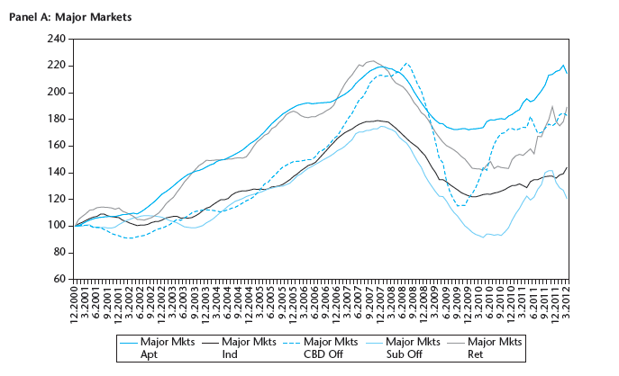
EXHIBIT 25-11 Moody’s/RCA CPPI Building-Block Indices (Panel A)
Source: Real Capital Analytics, Inc. (Index histories as of June 2012.)

Slide 35
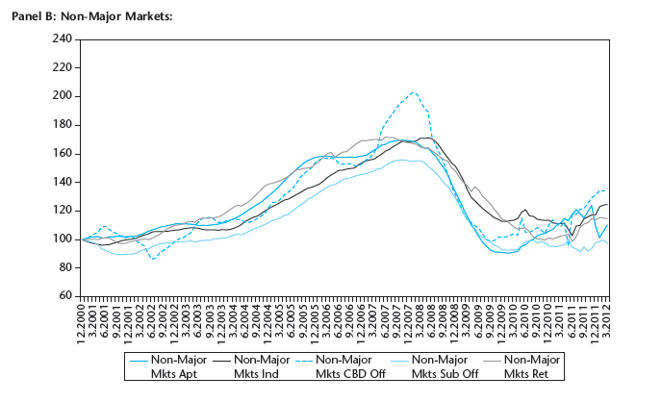
EXHIBIT 25-11 Moody’s/RCA CPPI Building-Block Indices (Panel B)
Source: Real Capital Analytics, Inc. (Index histories as of June 2012.)

Slide 36
25.5 Chapter Summary

Slide 37
KEY TERMS
NCREIF Property Index (NPI)
error
random noise
Square Root of n Rule
temporal lag
volatility effects (of return errors)
covariance effects
moving average
smoothing (or appraisal smoothing)
beta effects
cross-correlation effects
autocorrelation effects
price discovery
Index 1 (REIT-based returns)
Index 2 (constant-liquidity private market returns)
Index 3 (observable contemporaneous transaction price returns)
Index 4 (contemporaneous appraisal-based returns)
Index 5 (staggered appraisal-based index returns)
noise-versus-lag trade-off
repeat-sales price index

