Slide 1
Chapter 23
REAL ESTATE INVESTMENT TRUSTS (REITs)

Slide 2
CHAPTER OUTLINE
23.1 Introduction to REITs
23.1.1 Tax Status and Regulatory Constraints
23.1.2 A Brief History of REITs in the United States
23.2 REIT Analysis and Valuation
23.2.1 Introduction to REIT Earnings Measures
23.2.2 Valuing REITs as a Stream of Cash Flows: the Gordon Growth Model
23.2.3 Valuing REITs as Collections of Assets: Parallel Asset Markets and NAV-Based Valuation
23.2.4 REIT Public/Private Arbitrage
23.3 Some Considerations of REIT Management Strategy
23.4 Chapter Summary: Some REIT Investor Considerations

Slide 3
LEARNING OBJECTIVES
After reading this chapter, you should understand:
The basic process of macro-level valuation at the investment entity level as exemplified in the valuation of public REITs by the stock market.
The basic regulatory constraints faced by REITs and some of the unique accounting terminology and conventions used in the analysis of REIT stocks.
The difference between growth and income stocks and the nature of REITs in this regard.
Some of the major considerations and objectives in REIT management strategy.

Slide 4
23.1 Introduction to REITs

Slide 5
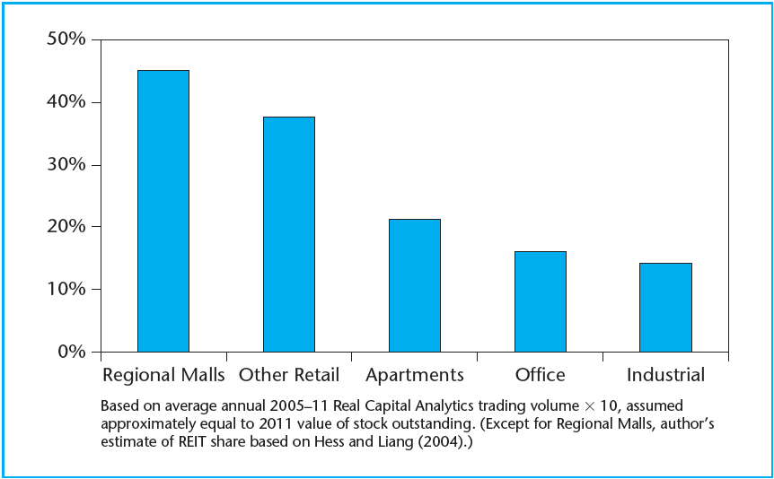
EXHIBIT 23-1 Estimated REIT % Ownership of Major ($5M+) CRE Properties by Value, 2011
Source: Authors’ estimates based on data from NAREIT and Real Capital Analytics.

Slide 6
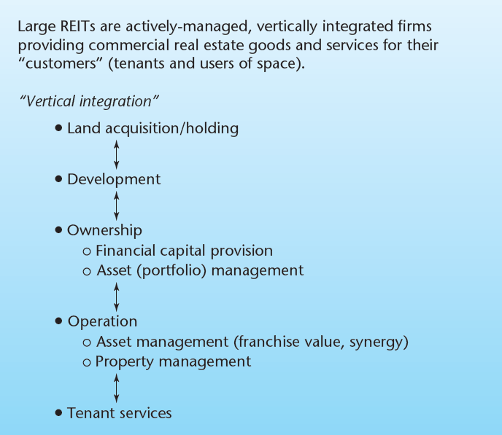
EXHIBIT 23-2 Vertical Integration in REITs
Copyright © 2021 Mbition LLC. All rights reserved.

Slide 7
23.1.1 Tax Status and Regulatory Constraints

Slide 8
23.1.2 A Brief History of REITs in the United States

Slide 9
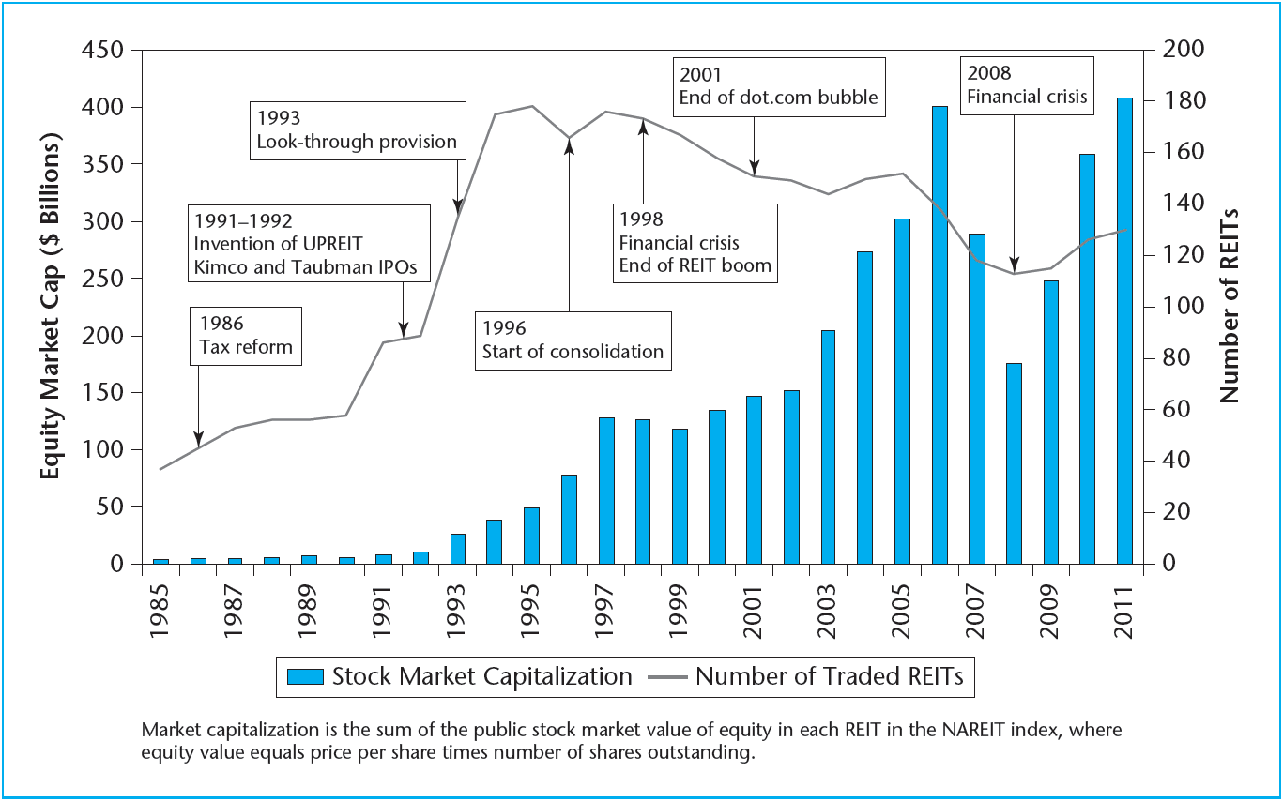
EXHIBIT 23-3 Size of U.S. Equity REIT Sector, 1985–2011
Source: Based on data from the National Association of Real Estate Investment Trusts (NAREIT).

Slide 10
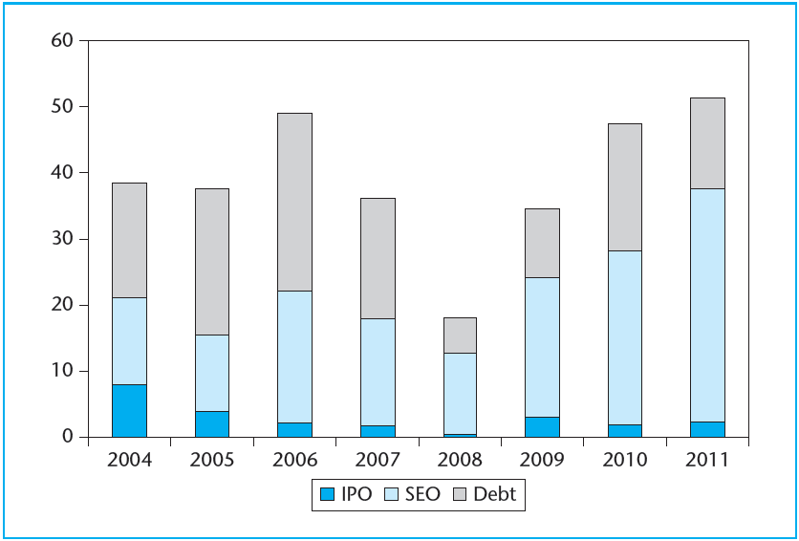
EXHIBIT 23-4 External Capital Raised by U.S. REITs ($billions), 2004–2011
Source: Based on data from National Association of Real Estate Investment Trusts (NAREIT).

Slide 11
23.2 REIT Analysis and Valuation

Slide 12
23.2.1 Introduction to REIT Earnings Measures

Slide 13
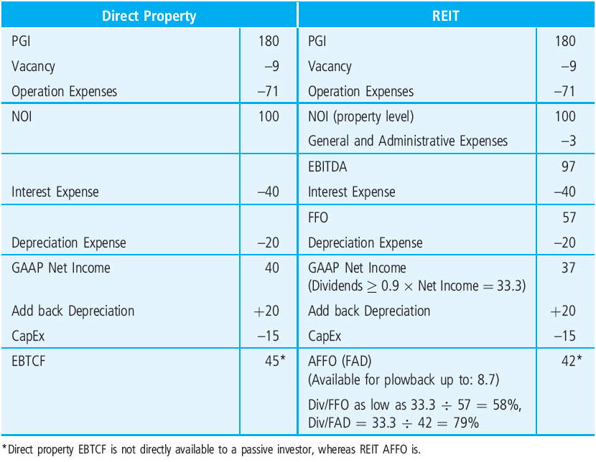
EXHIBIT 23-5 Widely Used Direct Property vs. REIT Income Measures
Copyright © 2021 Mbition LLC. All rights reserved.

Slide 14
23.2.2 Valuing REITs as a Stream of Cash Flows: The Gordon Growth Model

Slide 15
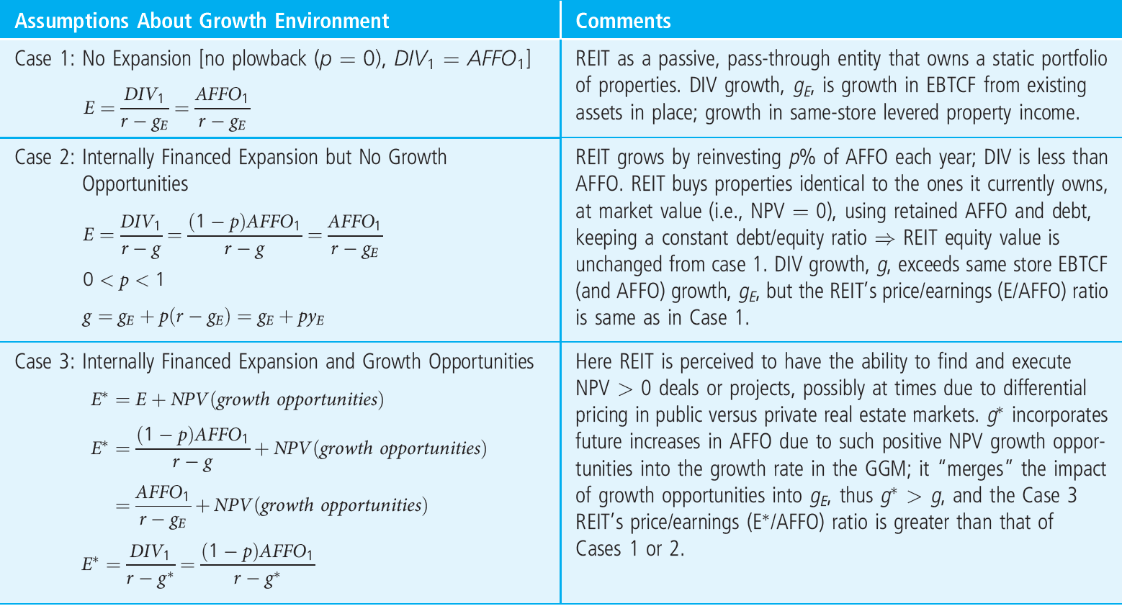
EXHIBIT 23-6 The Dividend (Gordon) Growth Model of REIT Share Prices: A Summary
Copyright © 2021 Mbition LLC. All rights reserved.

Slide 16
23.2.3 Valuing REITs as Collections of Assets: Parallel Asset Markets and NAV-Based Valuation

Slide 17
23.2.4 REIT Public/Private Arbitrage

Slide 18
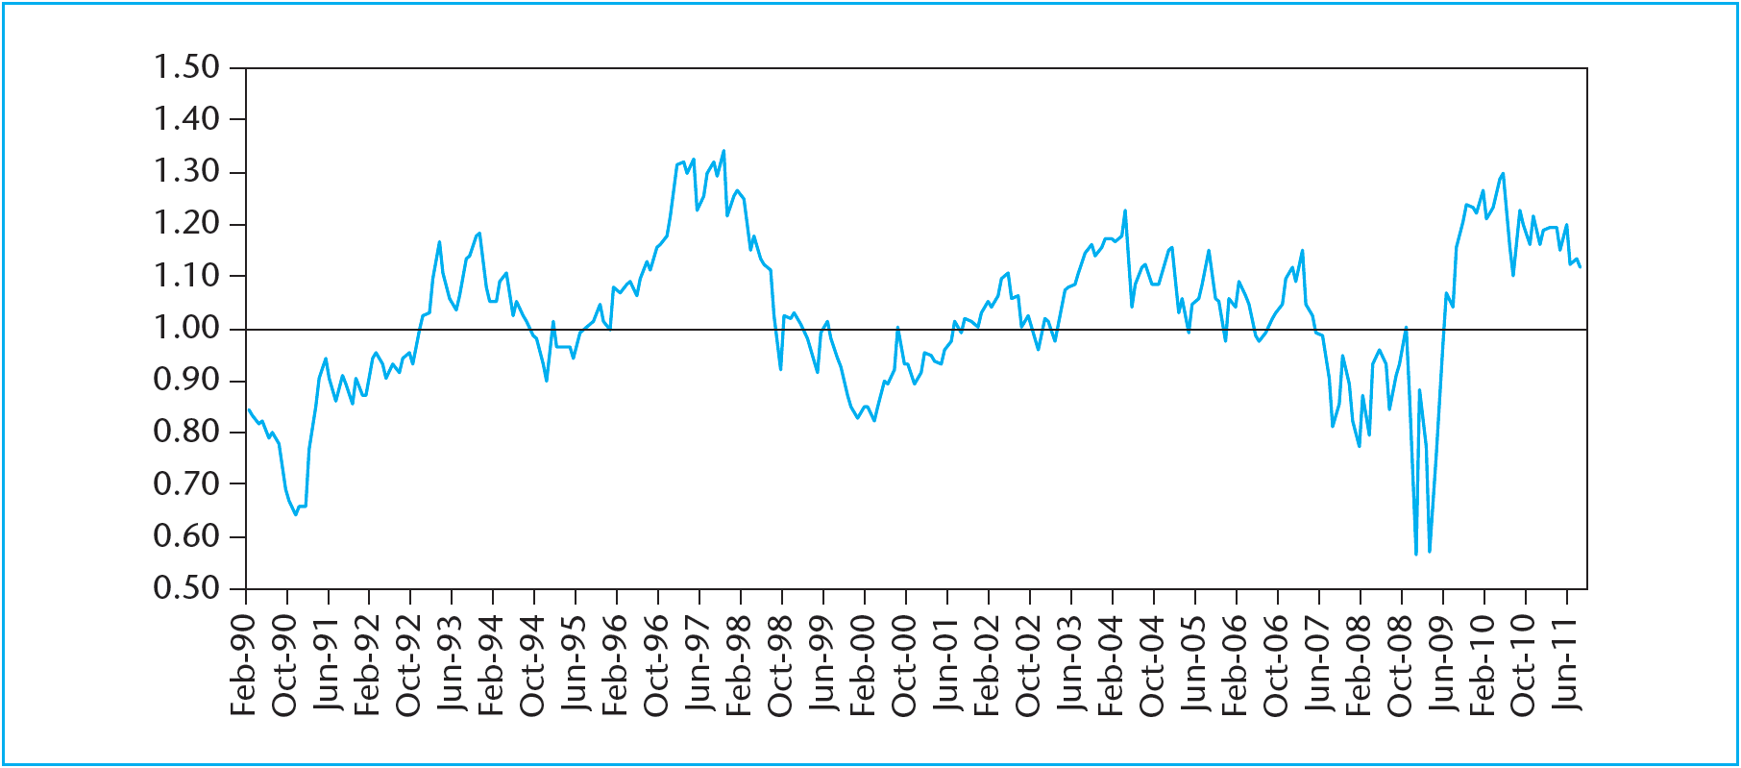
EXHIBIT 23-7 Green Street Average REIT Share Price/NAV Ratio History, 1990–2011
Source: Green Street Advisors, Inc., used with permission.

Slide 19
23.3 Some Considerations of REIT Management Strategy

Slide 20
23.4 Chapter Summary: Some REIT Investor Considerations

Slide 21
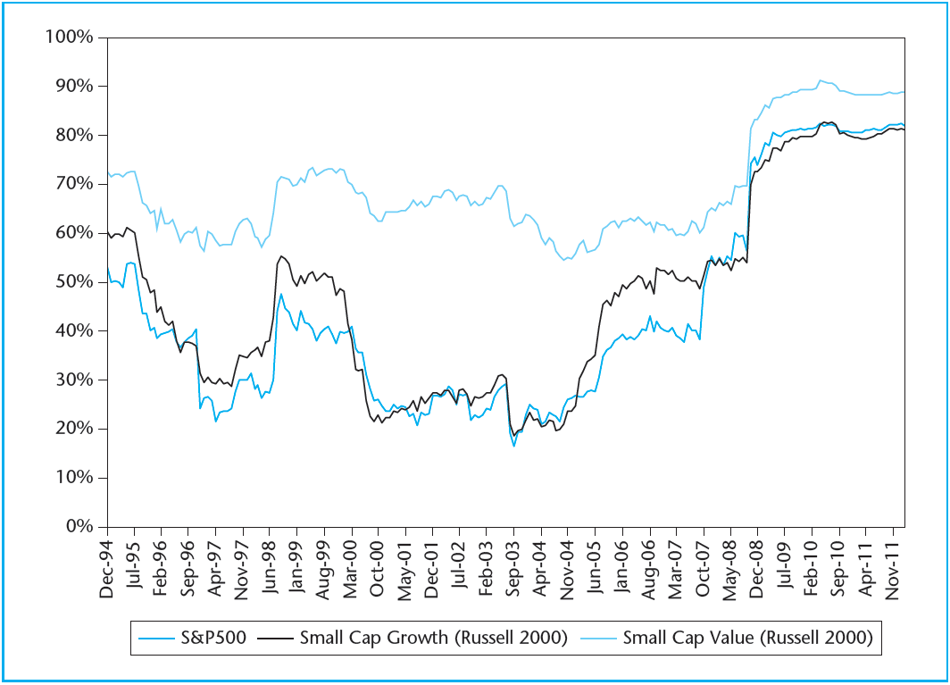
EXHIBIT 23-8 Correlation of Equity REIT Returns with Common Stock Returns (60-month rolling average).
Copyright © 2021 Mbition LLC. All rights reserved.

Slide 22
KEY TERMS
asset management
pure plays
look-through provision
five-or-fewer rule
taxable REIT subsidiary (TRS)
initial public offering (IPO) boom
Umbrella Partnership REIT
operating partnership (OP) units
GAAP net income
funds from operations (FFO)
earnings before interest, taxes, depreciation, and amortization (EBITDA)
equity-before-tax cash flow (EBTCF)
adjusted funds from operations (AFFO)
funds, or cash, available for distribution (FAD or CAD)
Gordon growth model (GGM)
plowback ratio
dividend payout ratio
assets in place
same-store growth
growth opportunities
average equity cost of capital
net asset value (NAV)
growth stocks
income stocks
value stocks
public/private arbitrage
vertical integration
economies of scale
brand name recognition
market power (in the space market)

