Slide 1
Chapter 22
Equilibrium Asset Valuation and Real Estate’s Price of Risk in the Capital Market

Slide 2
CHAPTER OUTLINE
22.1 Introduction and Some Threshold Points
22.1.1 Practical Uses for Asset Price Theory
22.1.2 A Threshold Point: What Underlies Asset Risk?
22.2 Review of Classical Asset Pricing Theory
22.2.1 From Portfolio Theory to the CAPM
22.2.2 The Main Point in the Basic CAPM
22.2.3 Isn’t the CAPM Wrong?
22.2.4 Strengths and Weaknesses in the Basic CAPM
22.3 Applying the CAPM to the Private Real Estate Asset Class as a Whole
22.3.1 Brief History
22.3.2 Broadening the Market Portfolio and Correcting for Smoothing
22.4 Attempting to Quantify Risk and Return within the Private Real Estate Asset Class
22.5 Chapter Summary

Slide 3
LEARNING OBJECTIVES
After reading this chapter, you should understand:
What is meant by equilibrium asset pricing models and how these tools are used in practice to aid macro-level investment decision making.
The classical CAPM and its major theoretical and practical strengths and weaknesses.
How the CAPM can be (or why it should be) applied to real estate and where it falls down in this regard, including a distinction between application at the overall multi-asset-class portfolio level and application at the more specific level within the private real estate asset class.

Slide 4
22.1 Introduction and Some Threshold Points

Slide 5
22.1.1 Practical Uses for Asset Price Theory

Slide 6
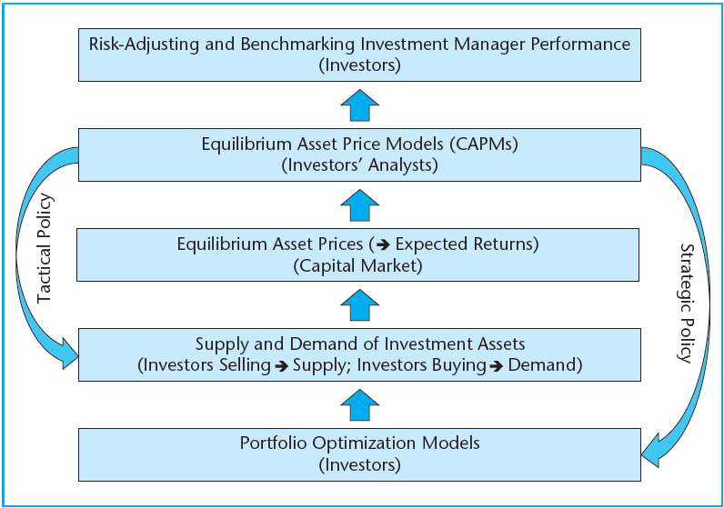
EXHIBIT 22-1 The Relationship between Equilibrium Asset Price Models and Investment Policy
Copyright © 2021 Mbition LLC. All rights reserved.

Slide 7
22.1.2 A Threshold Point: What Underlies Asset Risk?

Slide 8
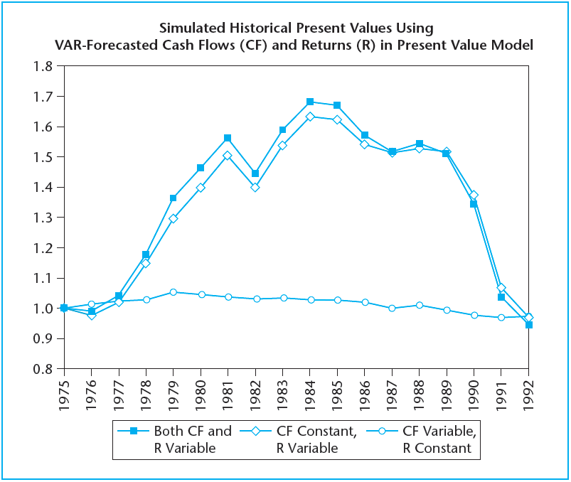
EXHIBIT 22-2 The Effect of Varying Cash Flow Expectations and Varying Return Expectations in a Present Value Model of Commercial Property
Source: Geltner and Mei (1995).

Slide 9
22.2 Review of Classical Asset Pricing Theory

Slide 10
22.2.1 From Portfolio Theory to the CAPM

Slide 11
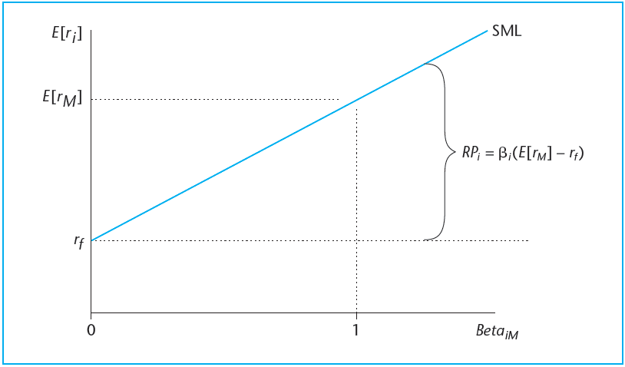
EXHIBIT 22-3 The CAPM in Graphical Form (the Security Market Line)
Copyright © 2021 Mbition LLC. All rights reserved.

Slide 12
22.2.2 The Main Point in the Basic CAPM

Slide 13
22.2.3 Isn’t the CAPM Wrong?

Slide 14
22.2.4 Strengths and Weaknesses in the Basic CAPM

Slide 15
22.3 Applying the CAPM to the Private Real Estate Asset Class as a Whole

Slide 16
22.3.1 Brief History

Slide 17
22.3.2 Broadening the Market Portfolio and Correcting for Smoothing

Slide 18
EXHIBIT 22-4A Typical Risk and Return Expectations

Slide 19
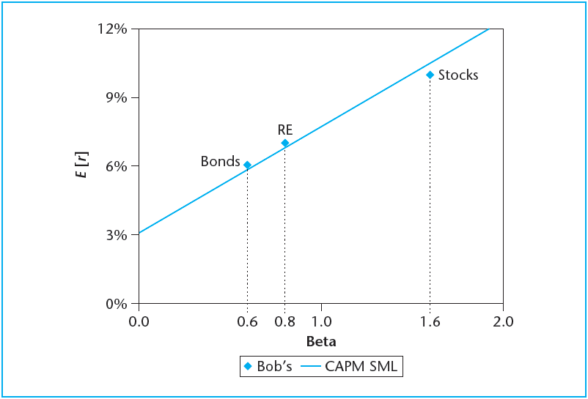
EXHIBIT 22-4B Bob’s Expectations and the CAPM Prediction
Copyright © 2021 Mbition LLC. All rights reserved.

Slide 20
22.4 Attempting to Quantify Risk and Return within the Private Real Estate Asset Class

Slide 21
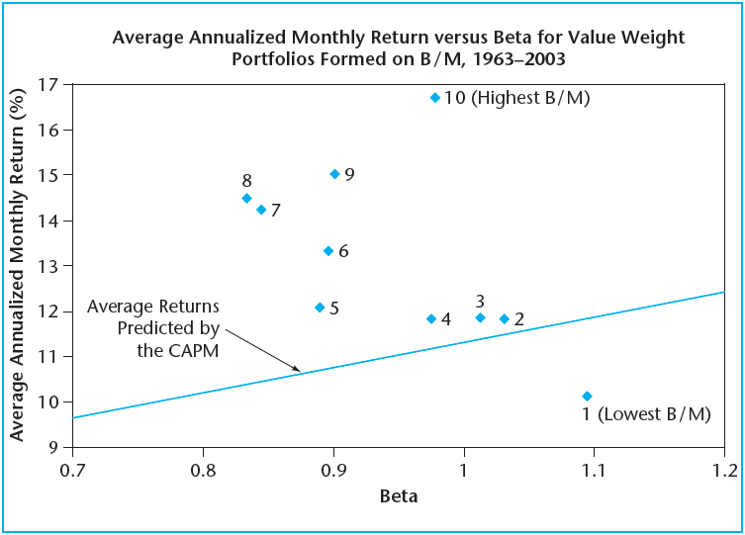
EXHIBIT 22-5 Stock Market Historical Fama-French Book/Market Value Portfolios Return versus Beta
Source: Reproduced from Fama and French (2004), Figure 3.

Slide 22
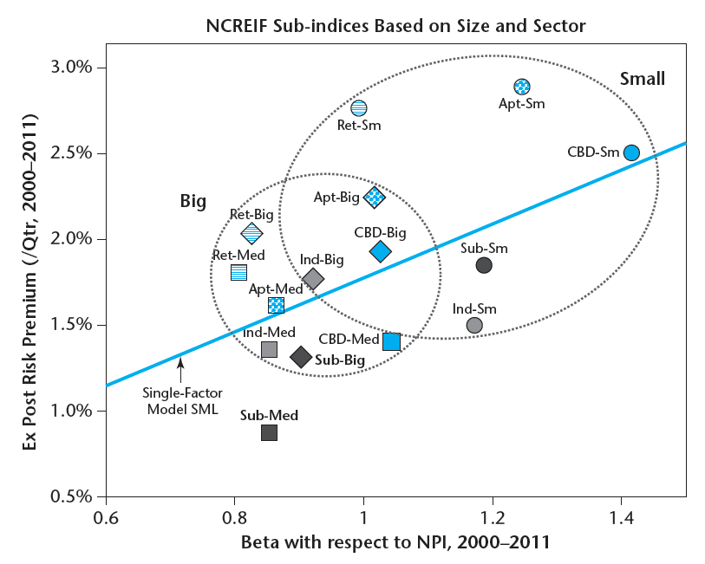
EXHIBIT 22-6 Risk and Return within Private Institutional Commercial Property, 2000–2011: NCREIF Subindices Based on Size and Sector
Source: Based on data from Jones (2012).

Slide 23
22.5 Chapter Summary

Slide 24
KEY TERMS
strategic investment decisions
tactical investment decisions
capital asset pricing model (CAPM)
market price of risk
market portfolio
beta
security market line (SML)
systematic (nondiversifiable) risk
specific (idiosyncratic) risk
segmented markets
risk factors
institutional quality real estate

