Slide 1
Chapter 2
Real Estate System

Slide 2
CHAPTER OUTLINE
2.1 Commercial Property Development Industry
2.2 Overview of the Real Estate System
2.3 Four-Quadrant Model
2.4 Using the 4Q Diagram to Help Understand Boom and Bust in Real Estate Markets
2.5 Chapter Summary

Slide 3
LEARNING OBJECTIVES
After reading this chapter, you should understand:
The real estate system and how it relates to investment analysis of commercial property.
The short- and long-run linkages among the real estate space market, asset market, and the development industry that convert financial capital to new physical supply in the space market.
How negative feedback loops keep the system in balance in the long run, and positive feedback can lead to destructive spirals.
The role of forward-looking behavior, as well as forms of behavioral “discipline,” on the part of participants in various aspects of the real estate system in keeping the system in balance.
How cycles or periods of imbalance between supply and demand can occur in the absence of perfect foresight or result from systematic behavioral errors or positive feedback loops.

Slide 4
2.1 Commercial Property Development Industry

Slide 5
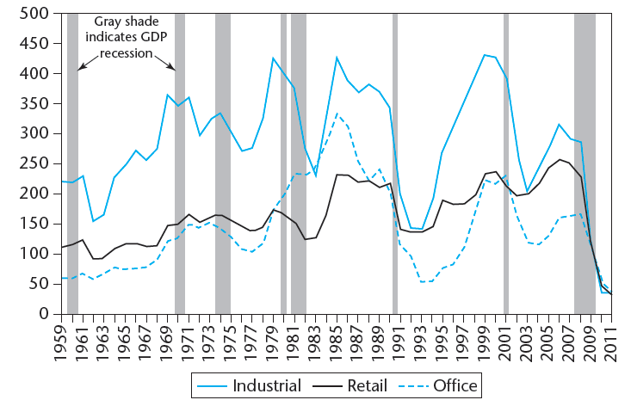
EXHIBIT 2-1 U.S. Commercial Property Construction Completions by Property Type (MSF): 1959–2011
Copyright © 2021 Mbition LLC. All rights reserved.
Sources: Construction start data from Property and Portfolio Research (CoStar Group Inc.); used with permission. Recession data from National Bureau of Economic Research.

Slide 6
2.2 Overview of the Real Estate System

Slide 7
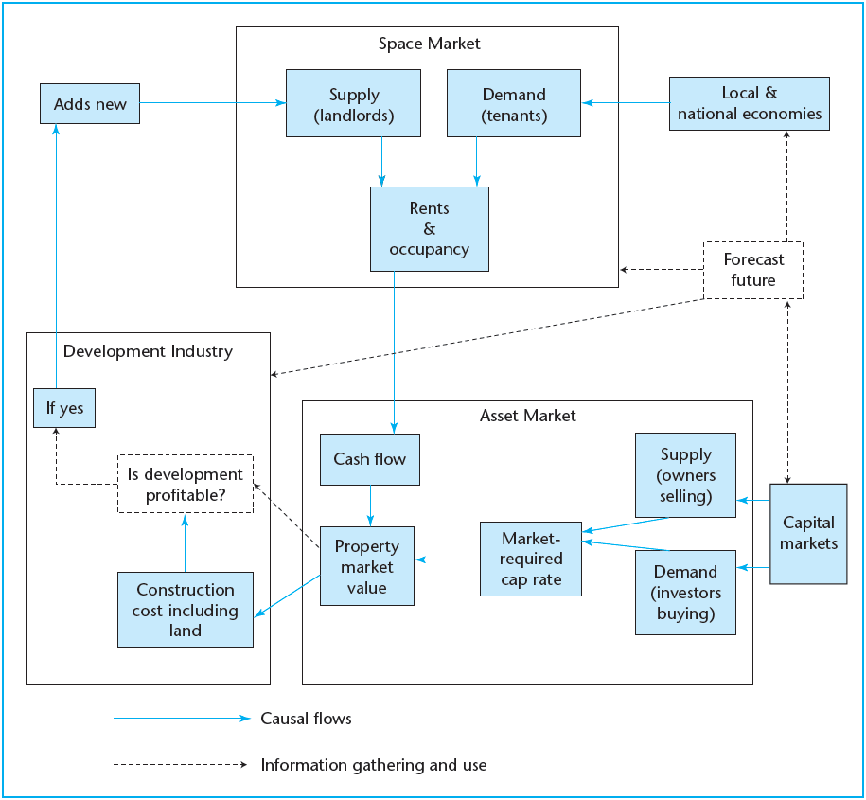
EXHIBIT 2-2 The Real Estate System: Interaction of the Space Market, Asset Market, and Development Industry
Copyright © 2021 Mbition LLC. All rights reserved.

Slide 8
2.3 Four-Quadrant Model

Slide 9
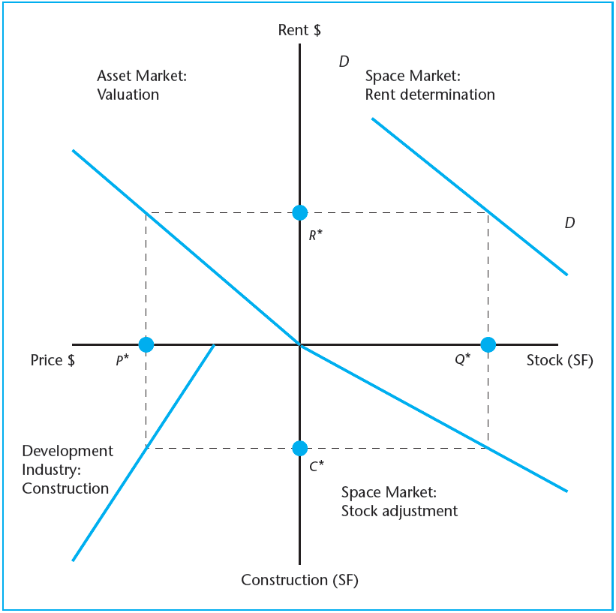
EXHIBIT 2-3 The DiPasquale-Wheaton Four-Quadrant Diagram
Copyright © 2021 Mbition LLC. All rights reserved.

Slide 10
2.4 Using the 4Q Diagram to Help Understand Boom and Bust in Real Estate Markets

Slide 11
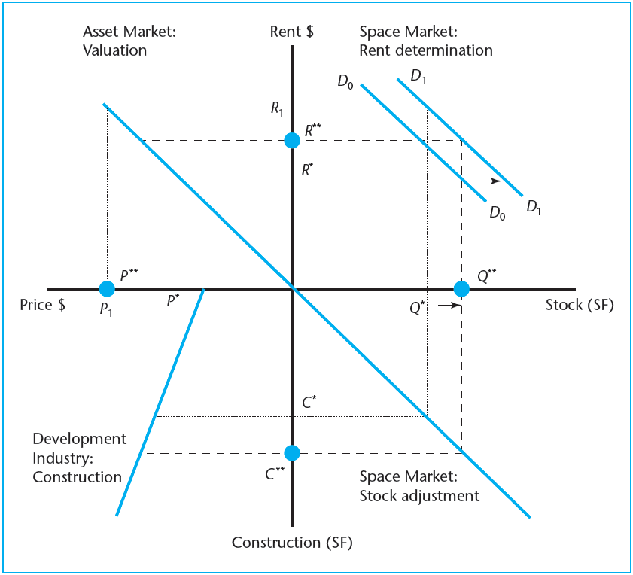
EXHIBIT 2-4A Effect of Demand Growth in Space Market
Copyright © 2021 Mbition LLC. All rights reserved.

Slide 12
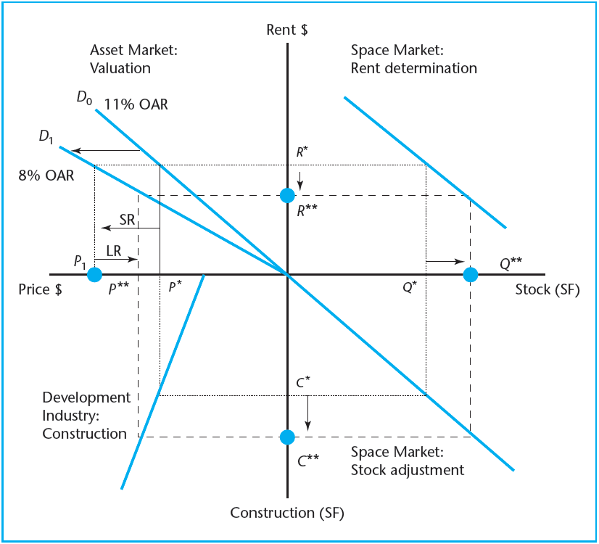
EXHIBIT 2-4B Effect of Demand Growth in Asset Market
Copyright © 2021 Mbition LLC. All rights reserved.

Slide 13
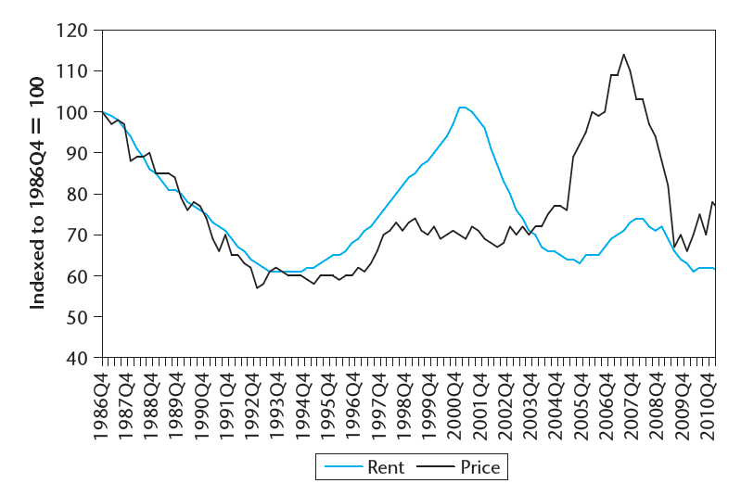
EXHIBIT 2-5 Example Space Market Rents and Asset Market Prices (adjusted for inflation): 1986–2011*
*The lines depicted here are illustrative examples typical of the US commercial real estate markets, but not exact correlates of the same markets. The rent line is based on asking rents for office space in seven major metro areas (source: CoStar); the asset price line is the NCREIF-based TBI (source: MIT) transaction price index for institutional investment property. Both the rent line and the asset price line are net of CPI inflation.
Sources: Based on data from CoStar Group Inc., NCREIF, MIT/CRE.

Slide 14
2.5 Chapter Summary

Slide 15
KEY TERMS
real estate system
systems dynamics model
negative feedback loop
positive feedback loop
four-quadrant model
long-run equilibrium
real estate market cycle
myopic price forecasts
physical capital/assets
financial capital/assets

