Slide 1
Chapter 19
Commercial Mortgage Economics and Investment

Slide 2
CHAPTER OUTLINE
19.1 Some Basic Characteristics of Bonds
19.1.1 Duration and Maturity
19.1.2 Interest Rate Risk and Preferred Habitat
19.1.3 The Yield Curve
19.1.4 Maturity Matching and the Management of Fixed-Income Portfolios
19.2 Commercial Mortgage Returns: Ex Ante and Ex Post
19.2.1 Mortgage Yield: The Components of Ex Ante Returns
19.2.2 Ex Post Performance: The Historical Record
19.3 Chapter Summary

Slide 3
LEARNING OBJECTIVES
After reading this chapter, you should understand:
The importance of the most basic concepts in bond investments and fixed-income portfolio management, such as duration, interest rate risk, and the yield curve.
The economics underlying commercial mortgage yields, that is, what drives investors’ required expected returns on mortgages.
The nature of recent historical ex post total return (HPR) performance of U.S. commercial mortgages.

Slide 4
19.1 Some Basic Characteristics of Bonds

Slide 5
19.1.1 Duration and Maturity

Slide 6
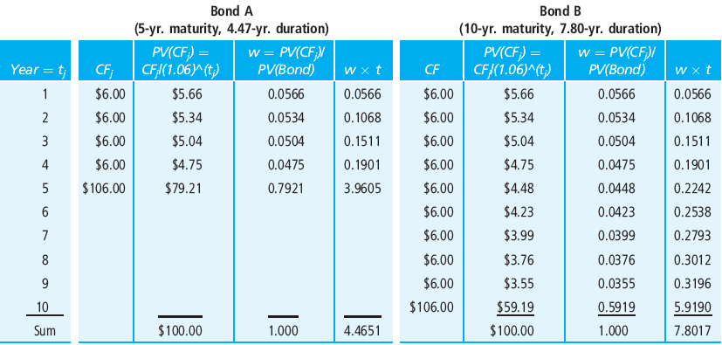
EXHIBIT 19-1 Computation of Duration at Par Value for Two Interest-Only, 6% Coupon, Annual-Payment Mortgages
Copyright © 2021 Mbition LLC. All rights reserved.

Slide 7
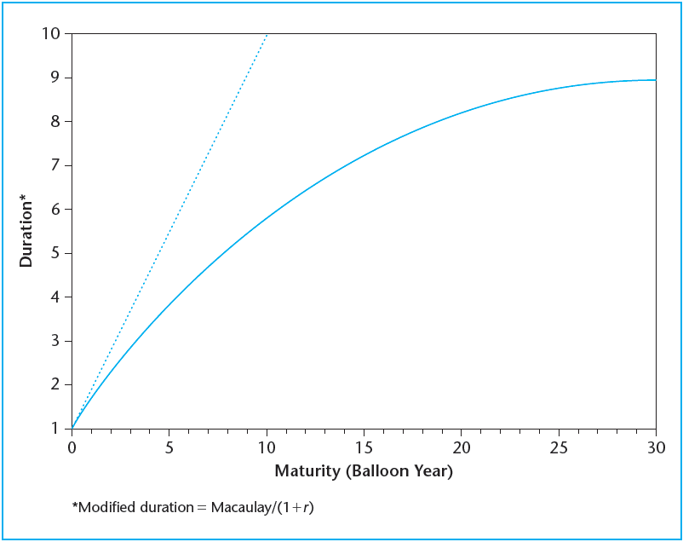
EXHIBIT 19-2 Duration as a Function of Maturity (30-year amortizing, 8% monthly-payment, at par)
Copyright © 2021 Mbition LLC. All rights reserved.

Slide 8
19.1.2 Interest Rate Risk and Preferred Habitat

Slide 9
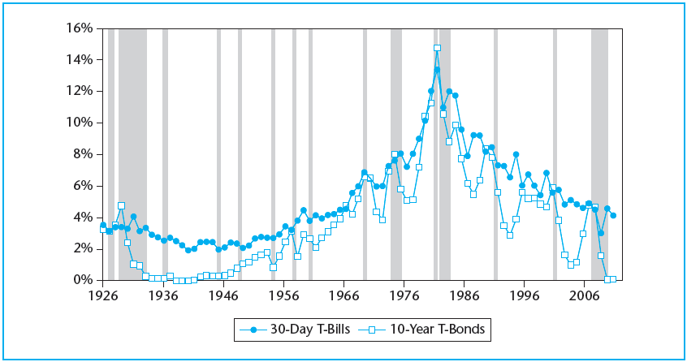
EXHIBIT 19-3 Short-term and Long-term U.S. Government Bond Yields, 1926–2010
Gray shaded vertical bands indicate periods of macro-economic recession (NBER designations).
Source: Based on data from Ibbostson Associates.

Slide 10
19.1.3 The Yield Curve

Slide 11
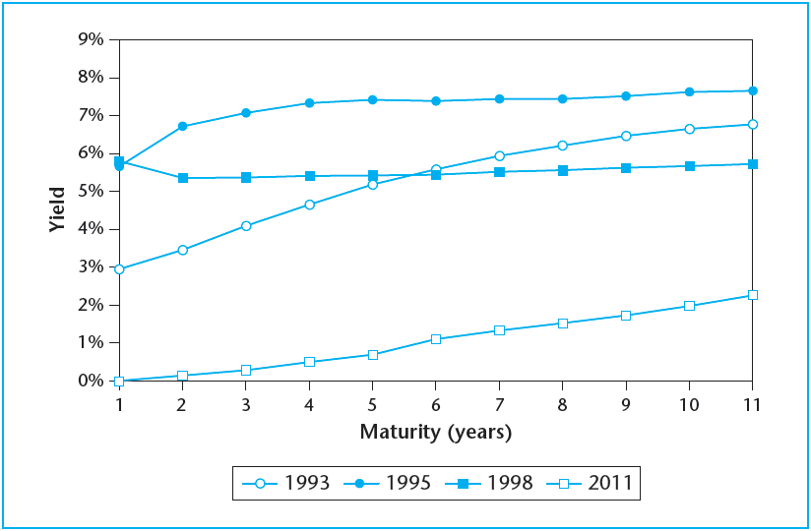
EXHIBIT 19-4 Yield Curve U.S. Treasury Strips
Copyright © 2021 Mbition LLC. All rights reserved.

Slide 12
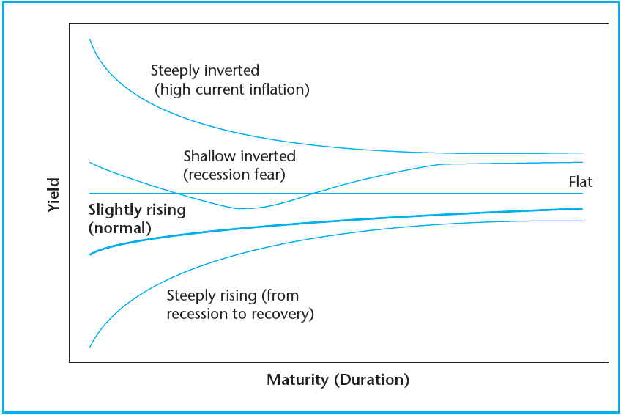
EXHIBIT 19-5 Typical Yield Curve Shapes
Copyright © 2021 Mbition LLC. All rights reserved.

Slide 13
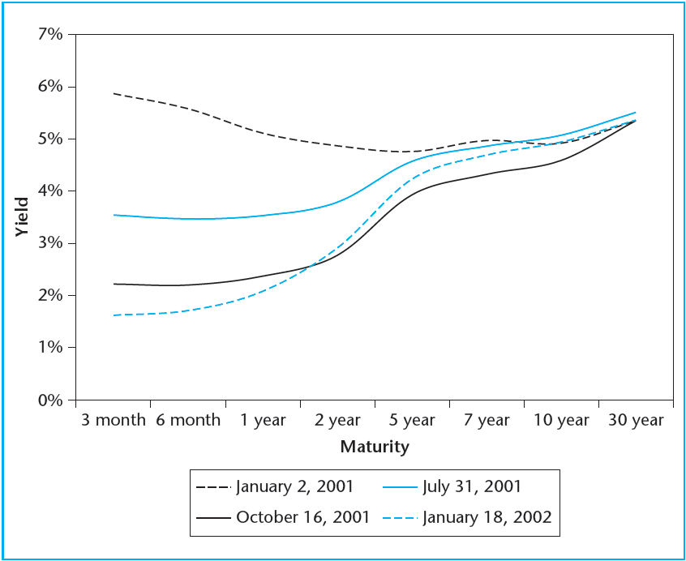
EXHIBIT 19-6 Yield Curve Changes During 2001
Copyright © 2021 Mbition LLC. All rights reserved.

Slide 14
19.1.4 Maturity Matching and the Management of Fixed-Income Portfolios

Slide 15
EXHIBIT 19-7A Simplified National Bank Balance Sheet as of 6/30/2013
Copyright © 2021 Mbition LLC. All rights reserved.

Slide 16
EXHIBIT 19-7B Simplified National Bank Balance Sheet as of 7/01/2013
Copyright © 2021 Mbition LLC. All rights reserved.

Slide 17
19.2 Commercial Mortgage Returns: Ex Ante and Ex Post

Slide 18
19.2.1 Mortgage Yield: The Components of Ex Ante Returns

Slide 19
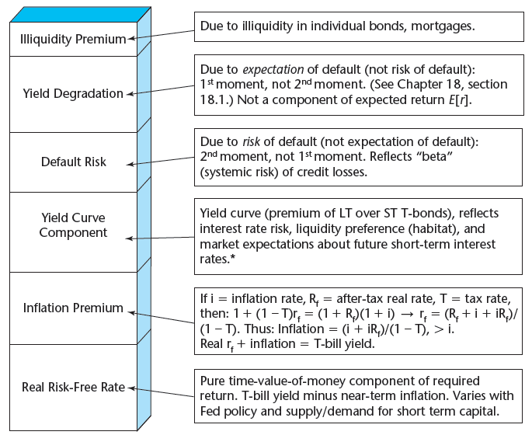
EXHIBIT 19-8 Components of Commercial Mortgage Total Yield: The Contractual Yield Components Stack
Copyright © 2021 Mbition LLC. All rights reserved.
Copyright © 2021 Mbition LLC. All rights reserved.
*Reflects expectations about LR future inflation (net over SR infla already in stack). Note that callable bonds have a callability or prepayment risk premium, closely related to this interest rate risk premium component.

Slide 20
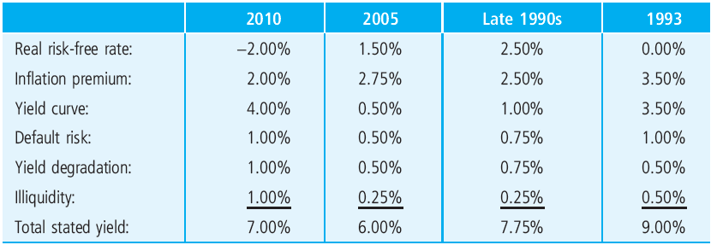
EXHIBIT 19-9 Approximate Commercial Mortgage Market Stated Yield Components at Four Historical Periods
Copyright © 2021 Mbition LLC. All rights reserved.

Slide 21
19.2.2 Ex Post Performance: The Historical Record

Slide 22
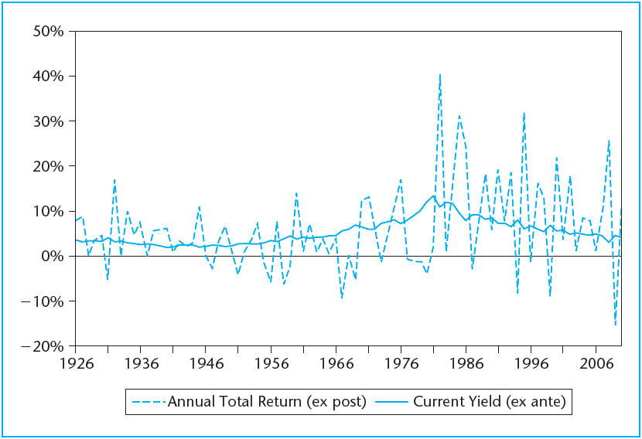
EXHIBIT 19-10 Yields (ex ante) and HPRs (ex post) on Long-Term U.S. Government Bonds, 1926–2004
Copyright © 2021 Mbition LLC. All rights reserved.

Slide 23
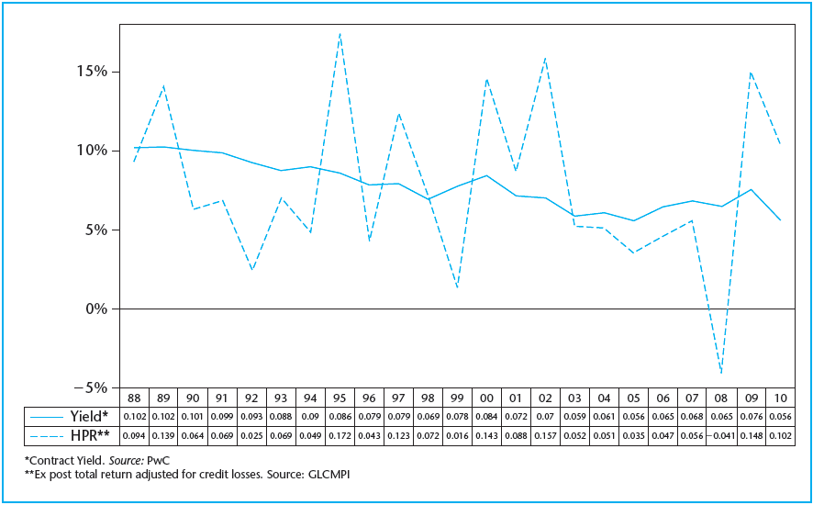
EXHIBIT 19-11 U.S. Commercial Mortgage Yields and HPRs
Copyright © 2021 Mbition LLC. All rights reserved.

Slide 24
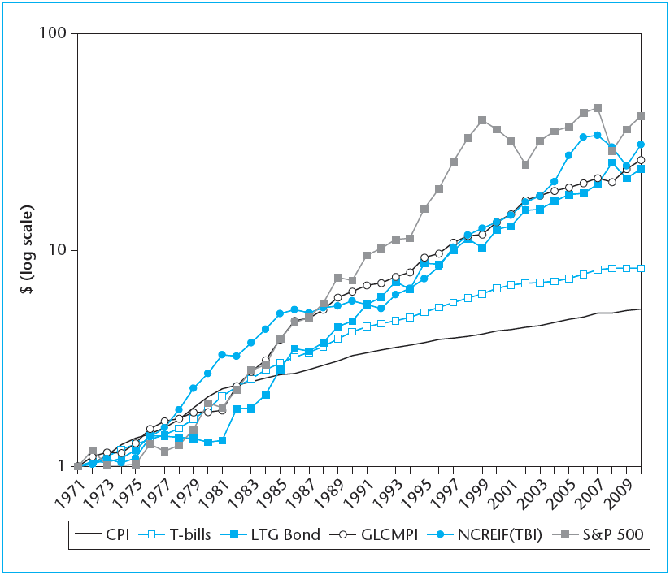
EXHIBIT 19-12 Year-End Value of $1 (income reinvested), 1971–2010
Copyright © 2021 Mbition LLC. All rights reserved.

Slide 25
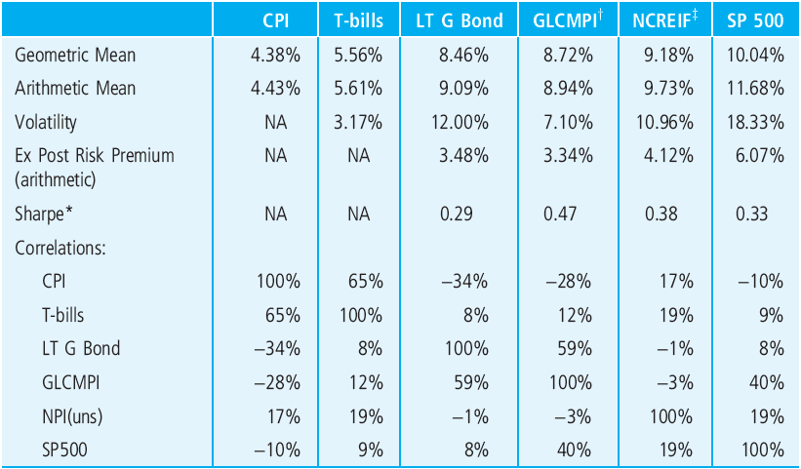
EXHIBIT 19-13 Historical Annual Periodic Total Return Statistics, 1972–2004
*The Sharpe Ratio is equal to: (Mean – T-bill Mean)/Volatility, a measure of return adjusted for risk.
†Adjusted for credit losses.
‡TBI from 1985, NCREIF Unsmoothed (1-Step, See Chapter 25) prior to then.
Sources: Based on data from Ibboston Associates; John B. Levy & Co. and NCREIF.

Slide 26
19.3 Chapter Summary

Slide 27
KEY TERMS
maturity
duration (Macaulay and modified)
interest rate risk
market yields
cash flow matching
roll-over strategy
preferred habitat
yield curve
expectations hypothesis
liquidity preference theory
maturity gap
portfolio lenders
trading-oriented strategies
immunization-oriented strategies
holding period returns (HPR)
contractual yield component “stack”
maturity matching
default risk
ex ante yield degradation
default risk premium
illiquidity premium

