Slide 1
Chapter 18
Commercial Mortgage Analysis and Underwriting

Slide 2
CHAPTER OUTLINE
18.1 Expected Returns versus Stated Yields: Measuring the Impact of Default Risk
  18.1.1 Yield Degradation and Conditional Cash Flows
  *18.1.2 Hazard Functions and the Timing of Default
  18.1.3 Yield Degradation in Typical Commercial Mortgages
18.2 Commercial Mortgage Underwriting
  18.2.1 Basic Property-Level Underwriting Criteria
  18.2.2 Variables and Loan Terms to Negotiate
  18.2.3 Numerical Example of the Normative Underwriting Process
18.3 Chapter Summary

Slide 3
LEARNING OBJECTIVES
After reading this chapter, you should understand:
How to quantify the effect of default risk on the expected returns to commercial mortgages.
How commercial mortgage underwriting procedures are related to default risk.
The major traditional procedures and measures used in commercial mortgage underwriting in the United States.

Slide 4
18.1 Expected Returns versus Stated Yields: Measuring the Impact of Default Risk

Slide 5
18.1.1 Yield Degradation and Conditional Cash Flows

Slide 6
*18.1.2 Hazard Functions and the Timing of Default

Slide 7
18.1.3 Yield Degradation in Typical Commercial Mortgages

Slide 8
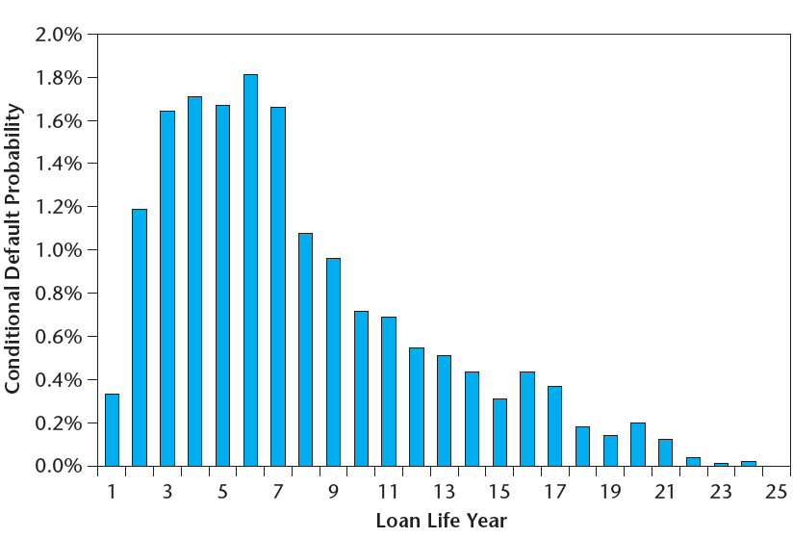
EXHIBIT 18-1 Typical Commercial Mortgage Hazard Rates
Source: Based on data from Esaki et al. 2002.

Slide 9
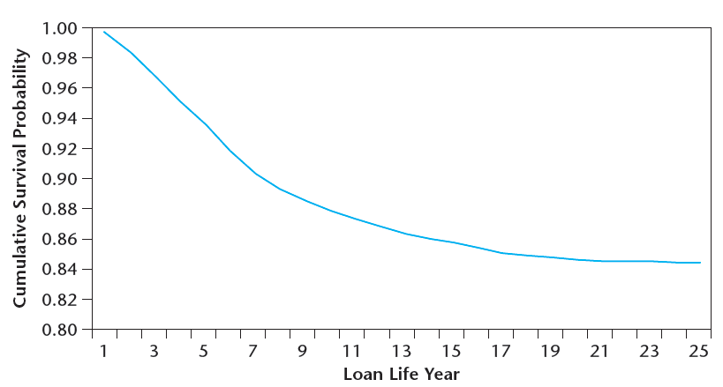
EXHIBIT 18-2 Typical Commercial Mortgage Survival Rates
Source: Based on data from Esaki et al. 2002.

Slide 10
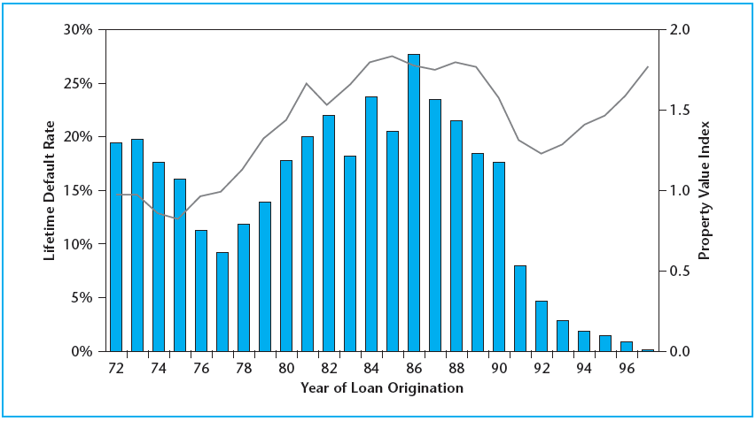
EXHIBIT 18-3 Lifetime Default Rates and Property Values
Sources: Based on data from Esaki, et al. 2002 and NCREIF Index.

Slide 11
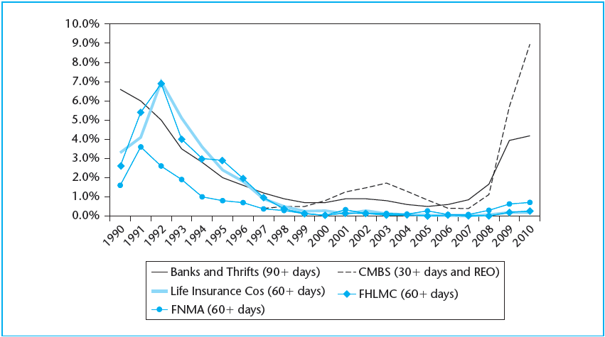
EXHIBIT 18-4 Default Rate in Outstanding Loans by Lender: 1990–2010*
*Excluding construction loans.
Source: Mortgage Bankers Association.

Slide 12
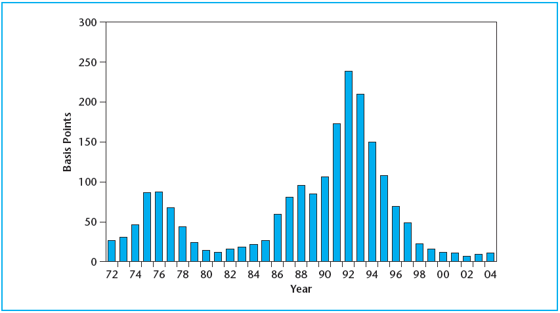
EXHIBIT 18-5 Commercial Mortgage Credit Loss as Fraction of Par Value
Source: Based on data from GLCMPI—John B. Levy & Co.

Slide 13
18.2 Commercial Mortgage Underwriting

Slide 14
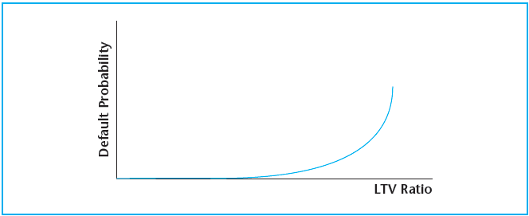
EXHIBIT 18-6 Typical Relationship between Initial LTV Ratio and the Ex Ante Lifetime Default Probability on a Commercial Property Mortgage
Copyright © 2021 Mbition LLC. All rights reserved.

Slide 15
18.2.1 Basic Property-Level Underwriting Criteria

Slide 16
18.2.2 Variables and Loan Terms to Negotiate

Slide 17
18.2.3 Numerical Example of the Normative Underwriting Process

Slide 18
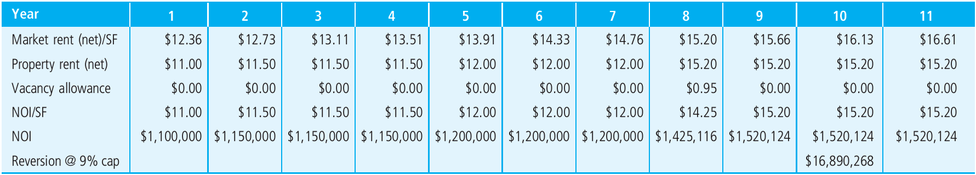
EXHIBIT 18-7A Broker’s Submitted Proforma for Bob’s Office Building
Copyright © 2021 Mbition LLC. All rights reserved.

Slide 19
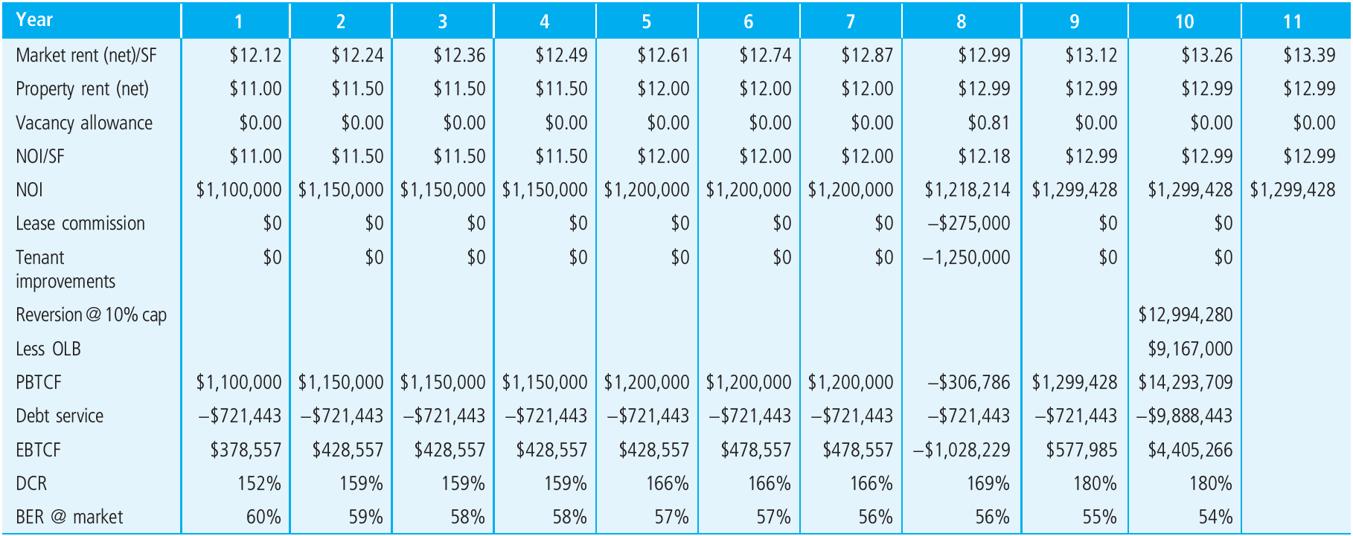
EXHIBIT 18-7B Sioux’s Modified Proforma for Bob’s Office Building and Loan Application
Copyright © 2021 Mbition LLC. All rights reserved.

Slide 20
18.3 Chapter Summary

Slide 21
KEY TERMS
contract (stated) yield
expected return (ex ante yield)
coupon (coupon rate)
credit losses
yield degradation
recovery rate
loss severity
conditional yield degradation
hazard probability/function
conditional survival probability
cumulative survival probability
unconditional default probability
cumulative (lifetime) default probability
ex ante (unconditional) yield degradation
ex post yield degradation
underwriting
initial loan-to-value ratio (ILTV)
volatility
debt service coverage ratio (DCR)
break-even ratio (BER)
equity-before-tax cash flow (EBTCF)
loan yield
terminal LTV (TLTV)

