Slide 1
Chapter 13
Use of Debt in Real Estate Investment: The Effect of Leverage

Slide 2
CHAPTER OUTLINE
The “Big Picture”
13.1 Basic Definitions and Mechanics of Leverage
13.2 Effect of Leverage on the Risk and Return to Equity
  13.2.1 Effect on the Expected Return
  13.2.2 Effect on the Risk in the Return
  13.2.3 Risk and Return: The Security Market Line
13.3 A Useful Formula: The WACC
  13.3.1 The WACC and REIT Cost of Capital
  13.3.2 Use of the WACC in Direct Property Investment
  13.3.3 The WACC and Return Components
  13.3.4 The WACC and Risk
13.4 Positive and Negative Leverage
13.5 Effect of Leverage on Growth and Yield
13.6 Chapter Summary

Slide 3
LEARNING OBJECTIVES
After reading this chapter, you should understand:
What is meant by the term “leverage” and how the use of debt financing affects the leverage of the equity investment.
How leverage affects the equity investor’s expected total return, and the income and appreciation components of that return.
How leverage affects the risk in the total return to equity, and therefore the market’s required risk premium in the ex ante return.
The weighted average cost of capital formula (WACC) and how this formula can be useful in quantifying leverage effects in theory, and in making practical approximations.
What is meant by the term “positive leverage,” and the conditions that result in such leverage.
How the use of debt, and its effect on leverage, enables the same underlying real property asset to serve investors with different objectives and concerns.

Slide 4
The “Big Picture”

Slide 5
13.1 Basic Definitions and Mechanics of Leverage

Slide 6
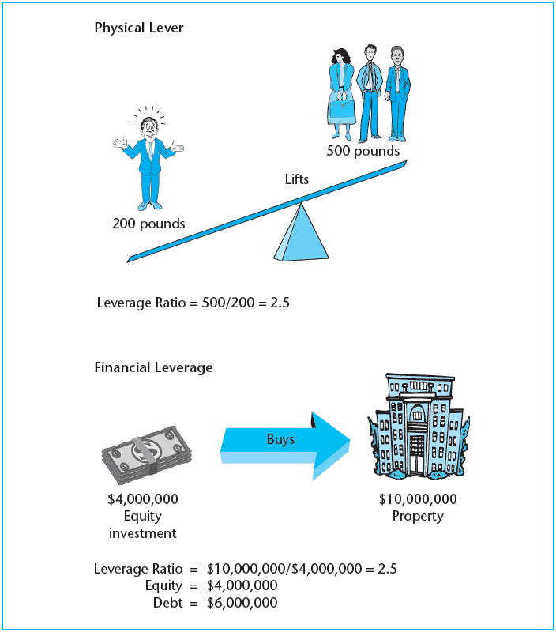
EXHIBIT 13-1 Analogy of Physical Leverage and Financial Leverage
Copyright © 2021 Mbition LLC. All rights reserved.

Slide 7
13.2 Effect of Leverage on the Risk and Return to Equity

Slide 8
13.2.1 Effect on the Expected Return

Slide 9
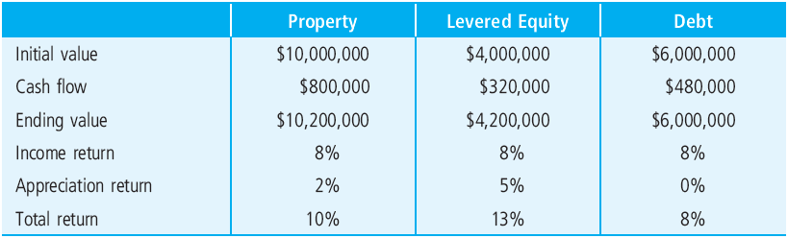
EXHIBIT 13-2 Typical Effect of Leverage on Expected Investment Returns
Copyright © 2021 Mbition LLC. All rights reserved.

Slide 10
13.2.2 Effect on the Risk in the Return

Slide 11
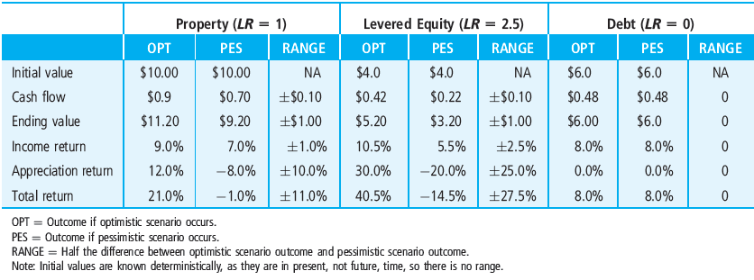
EXHIBIT 13-3 Sensitivity Analysis of Effect of Leverage on Risk in Equity Return Components, as Measured by Percentage Range in Possible Return Outcomes ($ values in millions)
Copyright © 2021 Mbition LLC. All rights reserved.

Slide 12
13.2.3 Risk and Return: The Security Market Line

Slide 13
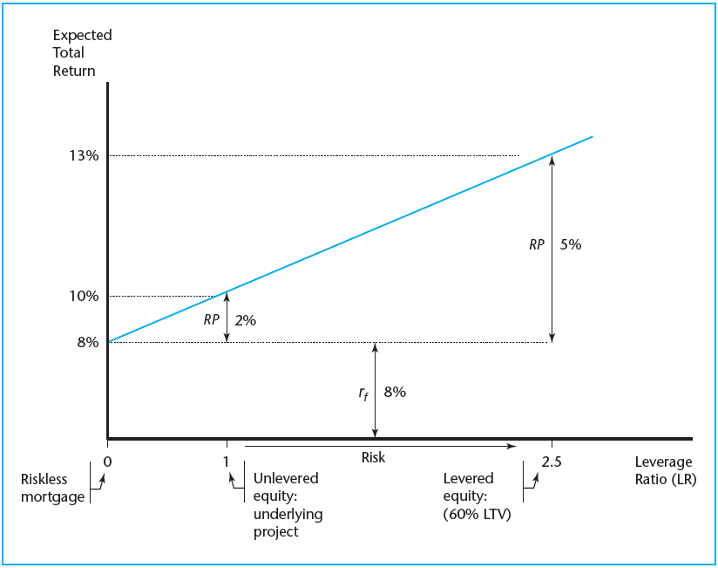
EXHIBIT 13-4 Effect of Leverage on Investment Risk and Return
Copyright © 2021 Mbition LLC. All rights reserved.

Slide 14
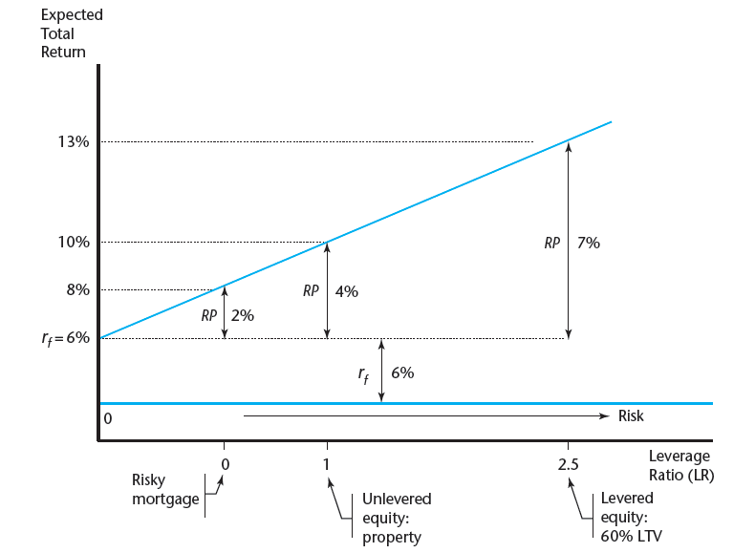
EXHIBIT 13-5 Effect of Leverage on Investment Risk and Return: A Risky Debt Example
Copyright © 2021 Mbition LLC. All rights reserved.

Slide 15
13.3 A Useful Formula: The WACC

Slide 16
13.3.1 The WACC and REIT Cost of Capital

Slide 17
13.3.2 Use of the WACC in Direct Property Investment

Slide 18
13.3.3 The WACC and Return Components

Slide 19
13.3.4 The WACC and Risk

Slide 20
13.4 Positive and Negative Leverage

Slide 21
13.5 Effect of Leverage on Growth and Yield

Slide 22
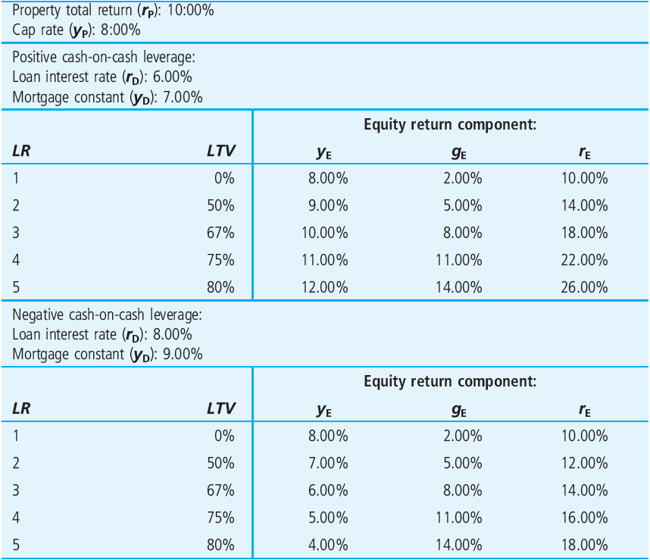
EXHIBIT 13-6 Typical Relative Effect of Leverage on Income and Growth Components of Investment Return (numerical example)
Copyright © 2021 Mbition LLC. All rights reserved.

Slide 23
13.6 Chapter Summary

Slide 24
KEY TERMS
leverage
heterogeneous investors
investment products
leverage ratio (LR)
equity
residual claim
loan-to-value ratio (LTV)
management incentive effects
volatility
default risk
market price of risk
weighted average cost of capital (WACC)
risk premium (RP)
equity cash yield
cash-on-cash return
positive leverage
negative leverage
mortgage constant (MC)

