Slide 1
Chapter 12
Advanced Micro-Level Valuation

Slide 2
CHAPTER OUTLINE
12.1 Market Value and Investment Value
12.1.1 How to Measure Investment Value
12.1.2 Joint Use of IV and MV in Decision Making
12.1.3 The Asset Market Model with Marginal and Intramarginal Investors: How to Get Positive NPV
12.2 Danger and Opportunity in Market Inefficiency
12.2.1 Valuation Noise
12.2.2 Asset Market Predictability
*12.3 Dueling Asset Markets: The REIT Market and the Property Market
12.3.1 Valuation at the Micro-Level
12.3.2 What about Informational Efficiency?
12.3.3 Micro-Level Risk Is in the Property, Not in the REIT
12.3.4 Summarizing the Dueling Markets: Going from the Micro to the Macro Perspective
12.4 Chapter Summary
Appendix 12A Basic Valuation Concepts: Transaction Prices, Market Values, and the Model of the Asset Market

Slide 3
LEARNING OBJECTIVES
After reading this chapter, you should understand:
The relationship between investment value (IV) and market value (MV) in the asset market, and how to use both of these concepts in real estate investment decision making.
The circumstances that make substantially positive NPV investment opportunities realistic.
The investment implications of imperfect price discovery in the real estate asset market.
The implications, for equity investors at the microlevel, of the simultaneous existence of two types or levels of real estate asset markets: the property market and the REIT market.
The difference between firm-level REIT cost of capital and the micro-level opportunity cost of capital applicable to REIT valuation of individual properties at the micro-level.

Slide 4
12.1 Market Value and Investment Value

Slide 5
12.1.1 How to Measure Investment Value

Slide 6
12.1.2 Joint Use of IV and MV in Decision Making

Slide 7
12.1.3 The Asset Market Model with Marginal and Intramarginal Investors: How to Get Positive NPV

Slide 8
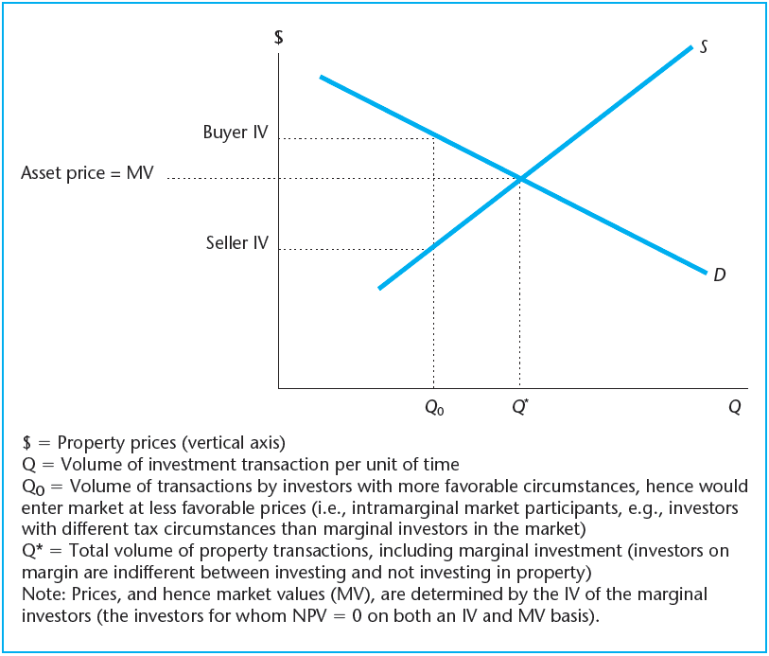
EXHIBIT 12-1 Relation between Investment Value (IV) and Market Value (MV) in a Well-Functioning Asset Market
Copyright © 2021 Mbition LLC. All rights reserved.

Slide 9
12.2 Danger and Opportunity in Market Inefficiency

Slide 10
12.2.1 Valuation Noise

Slide 11
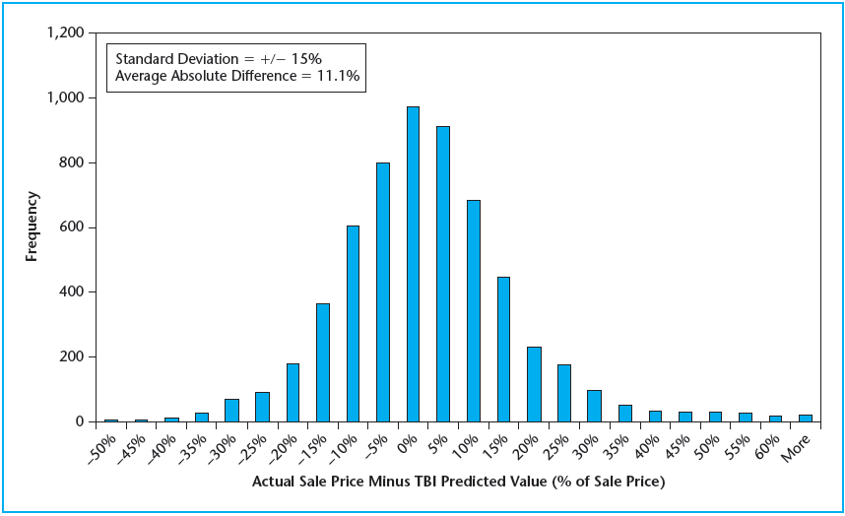
EXHIBIT 12-2 Histogram of Predicted Sale Price Error
Source: Authors’ analysis based on NCREIF data.

Slide 12
12.2.2 Asset Market Predictability

Slide 13
*12.3 Dueling Asset Markets: The REIT Market and the Property Market

Slide 14
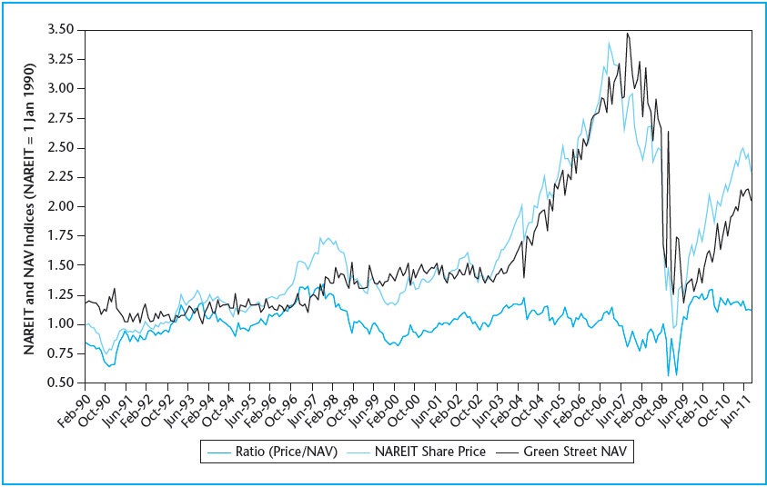
EXHIBIT 12-3 Equity REIT Share Prices versus Private Property Net Asset Values (NAVs)
Source: Authors’ calculations based on the NAREIT equity REIT share price index and REIT sector average premium to NAV data provided by Green Street Advisors.

Slide 15
12.3.1 Valuation at the Micro-Level

Slide 16
12.3.2 What about Informational Efficiency?

Slide 17
12.3.3 Micro-Level Risk Is in the Property, Not in the REIT

Slide 18
12.3.4 Summarizing the Dueling Markets: Going from the Micro to the Macro Perspective

Slide 19
12.4 Chapter Summary

Slide 20
Appendix 12A Basic Valuation Concepts: Transaction Prices, Market Values, and the Model of the Asset Market

Slide 21
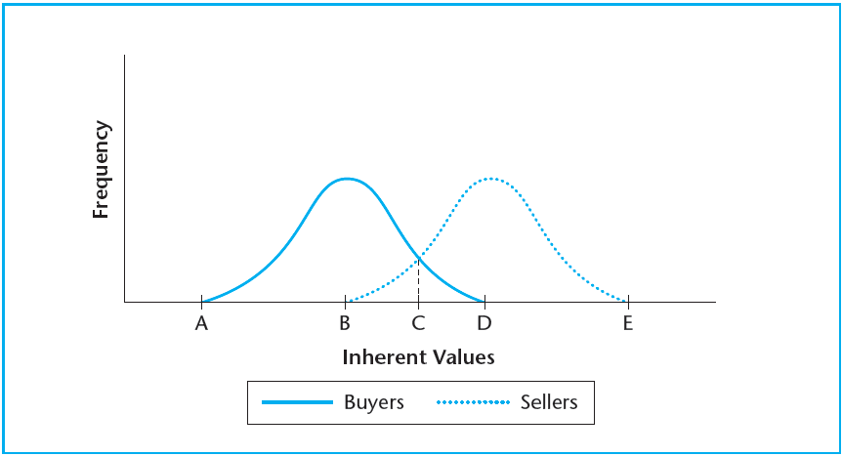
EXHIBIT 12A-1a Buyer and Seller Populations, Inherent Value Frequency Distributions
Copyright © 2021 Mbition LLC. All rights reserved.

Slide 22
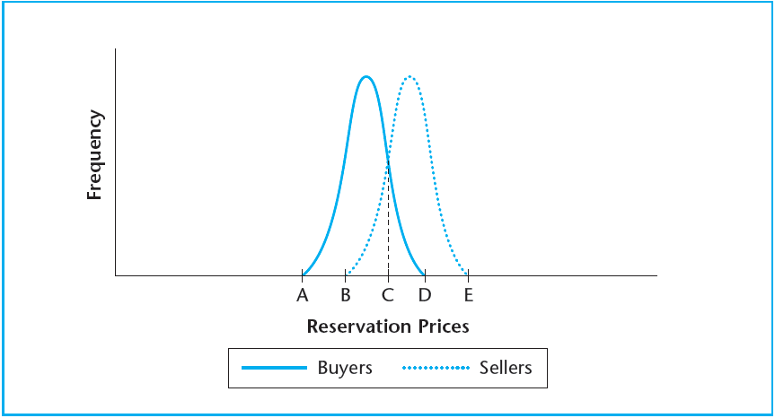
EXHIBIT 12A-1b Buyer and Seller Populations, Reservation Price Frequency Distributions
Copyright © 2021 Mbition LLC. All rights reserved.

Slide 23
KEY TERMS
market value (MV)
opportunity value
investment value (IV)
opportunity cost of capital (OCC)
second-most-motivated buyer
marginal investors
intramarginal investors
asset transaction market equilibrium
entrepreneurial profit
informational inefficiency (in asset markets)
random noise (in asset valuation)
due diligence
partial adjustment (of asset prices to news)
predictability (inertia in asset price movements)
market timing
transaction costs
supernormal profits
cycles
arbitrage
net asset value (NAV)
discount/premium to NAV
differential valuation (across asset markets)
growth opportunities (for REITs)
inherent value
usage value
transaction price
reservation price
price discovery
market density

