Slide 1
Chapter 1
Real Estate Space and Asset Markets

Slide 2
CHAPTER OUTLINE
1.1 Space Market
1.1.1 Segmentation of Space Markets: The Immobility of Real Estate
1.1.2 Supply, Demand, and Rent in the Space Market
1.1.3 Supply Is “Kinked”
1.1.4 Relation among Supply, Development Cost, and Rent
1.1.5 Forecasting the Future Direction of Rents
1.1.6 Is the Supply Function Rising, Level, or Falling?
1.2 Asset Market
1.2.1 Capital Markets
1.2.2 Magnitude of Real Estate Assets in the Overall Capital Market
1.2.3 Pricing of Real Estate Assets
1.2.4 Is the Asset Market Segmented Like the Space Market?
1.3 Chapter Summary

Slide 3
LEARNING OBJECTIVES
After reading this chapter, you should understand:
How to apply the basic economic concepts of supply and demand to commercial real estate markets.
The difference between the real estate space and asset markets.
The concept of market segmentation within the space market.
Why the long-run supply function in the space market is “kinked” and what that means to future rents.
The difference between, and relative magnitudes of, the public versus private asset markets, and the difference between equity and debt capital.
What a cap rate is and what determines cap rate prevailing in real estate markets.

Slide 4
1.1 Space Market

Slide 5
1.1.1 Segmentation of Space Markets: The Immobility of Real Estate

Slide 6
1.1.2 Supply, Demand, and Rent in the Space Market

Slide 7
Cincinnati skyline circa 1990
Cincinnati Museum Center-Cincinnati Historical Society Library

Slide 8
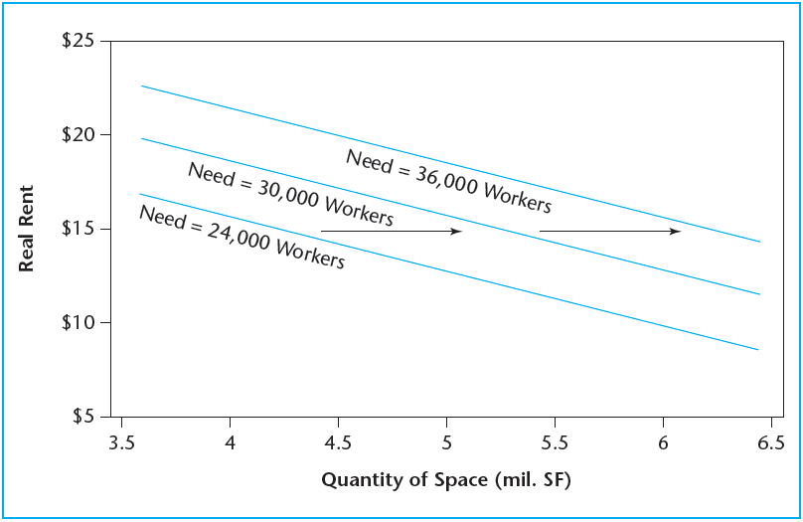
EXHIBIT 1-1 Office Demand as a Function of Employment
Copyright © 2021 Mbition LLC. All rights reserved.

Slide 9
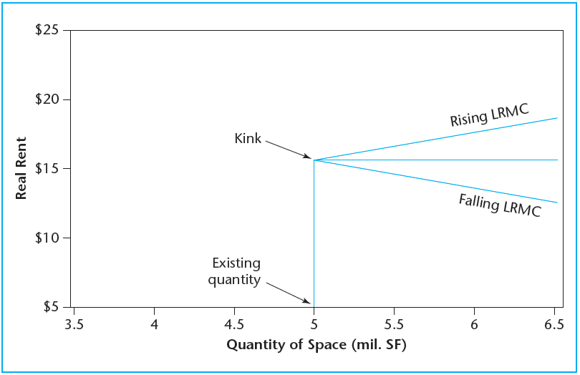
EXHIBIT 1-2 Real Estate Space Market Supply Function
Copyright © 2021 Mbition LLC. All rights reserved.

Slide 10
1.1.3 Supply Is “Kinked”

Slide 11
1.1.4 Relation among Supply, Development Cost, and Rent

Slide 12
1.1.5 Forecasting the Future Direction of Rents

Slide 13
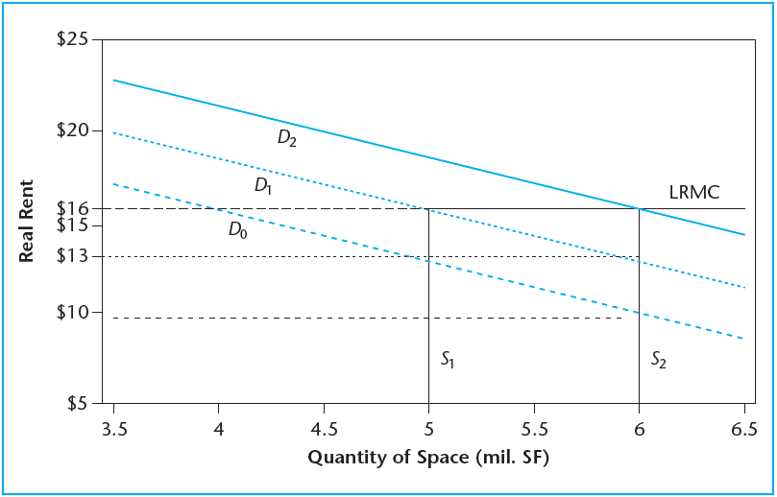
EXHIBIT 1-3 Change in Supply and Demand and Rent over Time
Copyright © 2021 Mbition LLC. All rights reserved.

Slide 14
1.1.6 Is the Supply Function Rising, Level, or Falling?

Slide 15
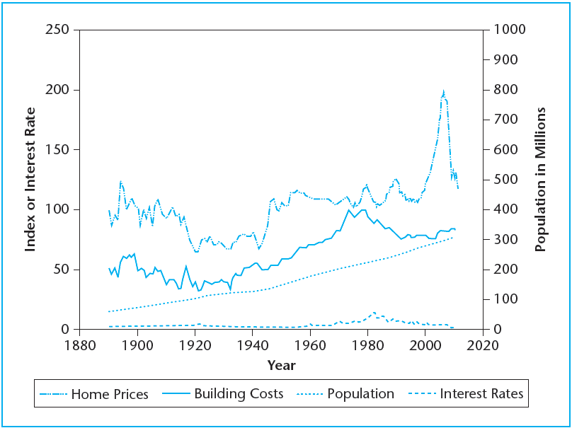
EXHIBIT 1-4 Long-Run History of Real Home Prices, Building Costs, Population, and Interest Rates in the United States
Source: Shiller, Robert J.; Irrational Exuberance, Second Edition. 2005 © Princeton University Press. Reprinted by permission of Princeton University Press.

Slide 16
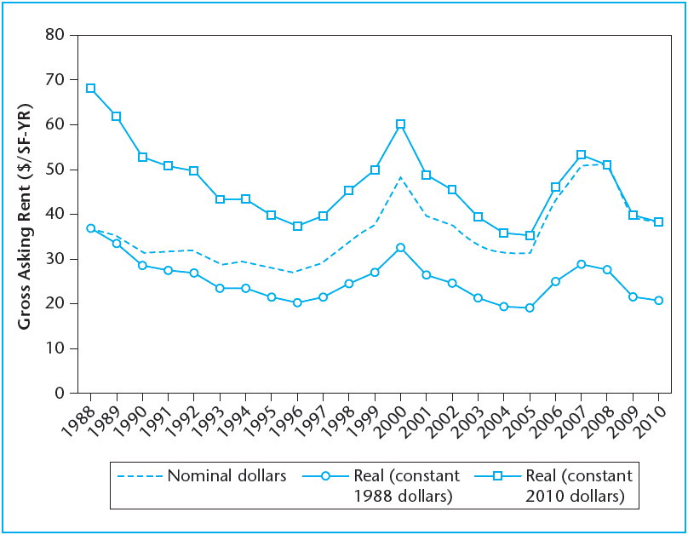
EXHIBIT 1-5 Manhattan Class A Office Market Rents, 1988–2010 Nominal and Real
Source: Data from CBRE Econometrics.

Slide 17
1.2 Asset Market

Slide 18
1.2.1 Capital Markets

Slide 19
EXHIBIT 1-6 Major Types of Capital Asset Markets and Investment Products

Slide 20
1.2.2 Magnitude of Real Estate Assets in the Overall Capital Market

Slide 21
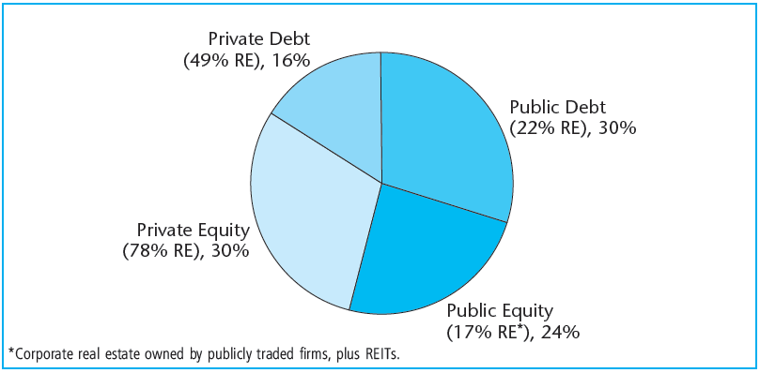
EXHIBIT 1-7 U.S. Capital Market Sectors, a $70 Trillion Pie
Source: Authors’ estimates based on Miles and Tolleson (1997), updated with FRB statistics.

Slide 22
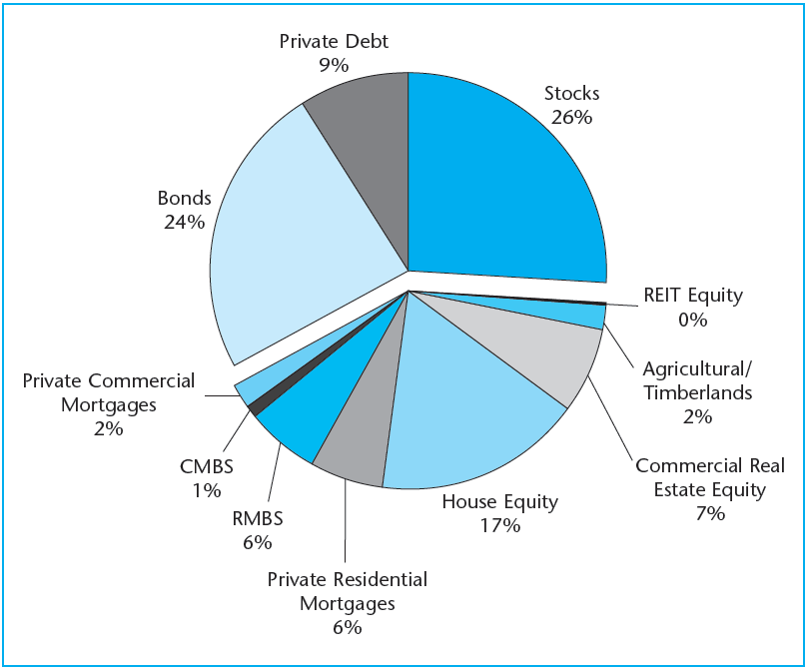
EXHIBIT 1-8 U.S. Investable Capital Market with Real Estate Components Broken Out
Source: Based on Miles and Tolleson (1997), updated with FRB statistics.

Slide 23
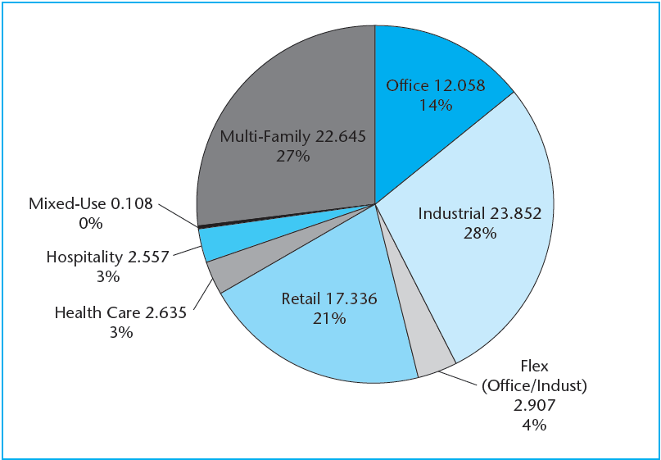
EXHIBIT 1-9A U.S. Commercial Property by Physical Stock (billions of square feet) Total = 84 BSF (excluding Specialty/Entertainment)
Source: Based on Florance et al. (2010).

Slide 24
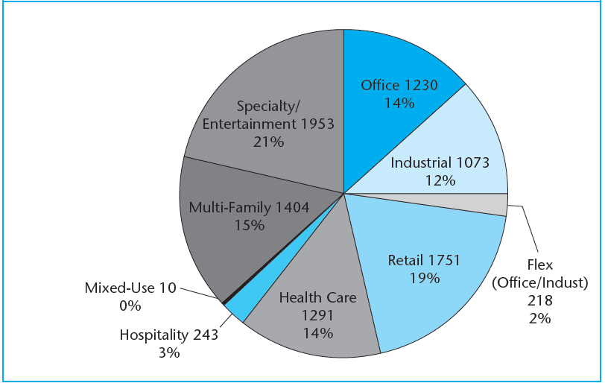
EXHIBIT 1-9B U.S. Commercial Property by Valuation ($ billions) Total = $9,173 billion
Source: Based on Florance et al. (2010).

Slide 25
1.2.3 Pricing of Real Estate Assets

Slide 26
1.2.4 Is the Asset Market Segmented Like the Space Market?

Slide 27
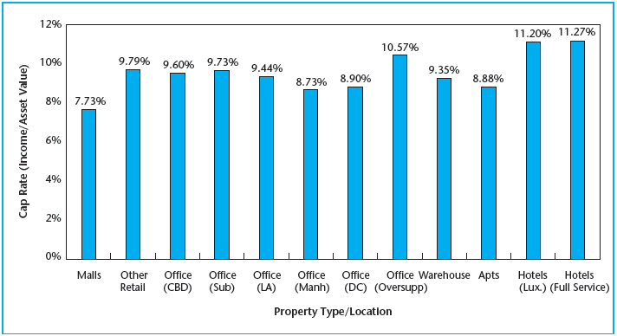
EXHIBIT 1-10 Cap Rates (OARs) for Commercial Property as of Third Quarter, 1994
Copyright © 2021 Mbition LLC. All rights reserved.

Slide 28
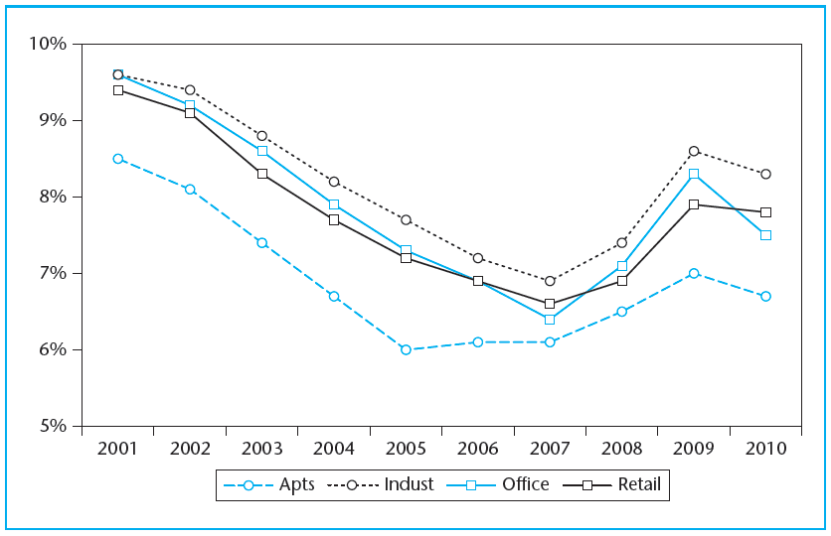
EXHIBIT 1-11 Average Commercial Property Transaction Cap Rates, 2001–2010
Source: Data from Real Capital Analytics Inc. used with permission.

Slide 29
1.3 Chapter Summary

Slide 30
KEY TERMS
market
space market
usage market
rental market
demand
supply
rent
segmented markets
metropolitan areas (MSAs)
downtowns, CBDs
property usage type
kinked supply function
replacement cost
equilibrium rent
cap rate
location rent
centrality
asset market
property market
capital market
public markets
liquidity
informational efficiency
private markets
whole assets
debt
underlying assets
equity
capitalization (cap) rate
overall rate (OAR)
current yield

